Slide 1
Willshire
Concept Plan Presentation to Planning Commission
June 14, 2017

Slide 2
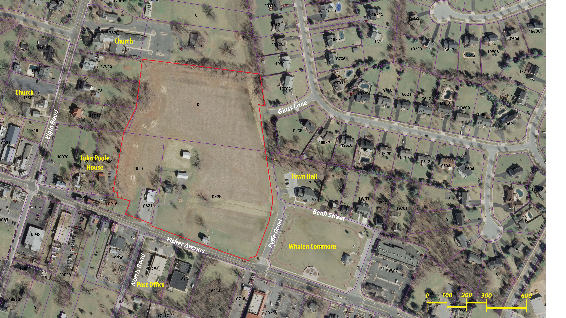

Slide 3
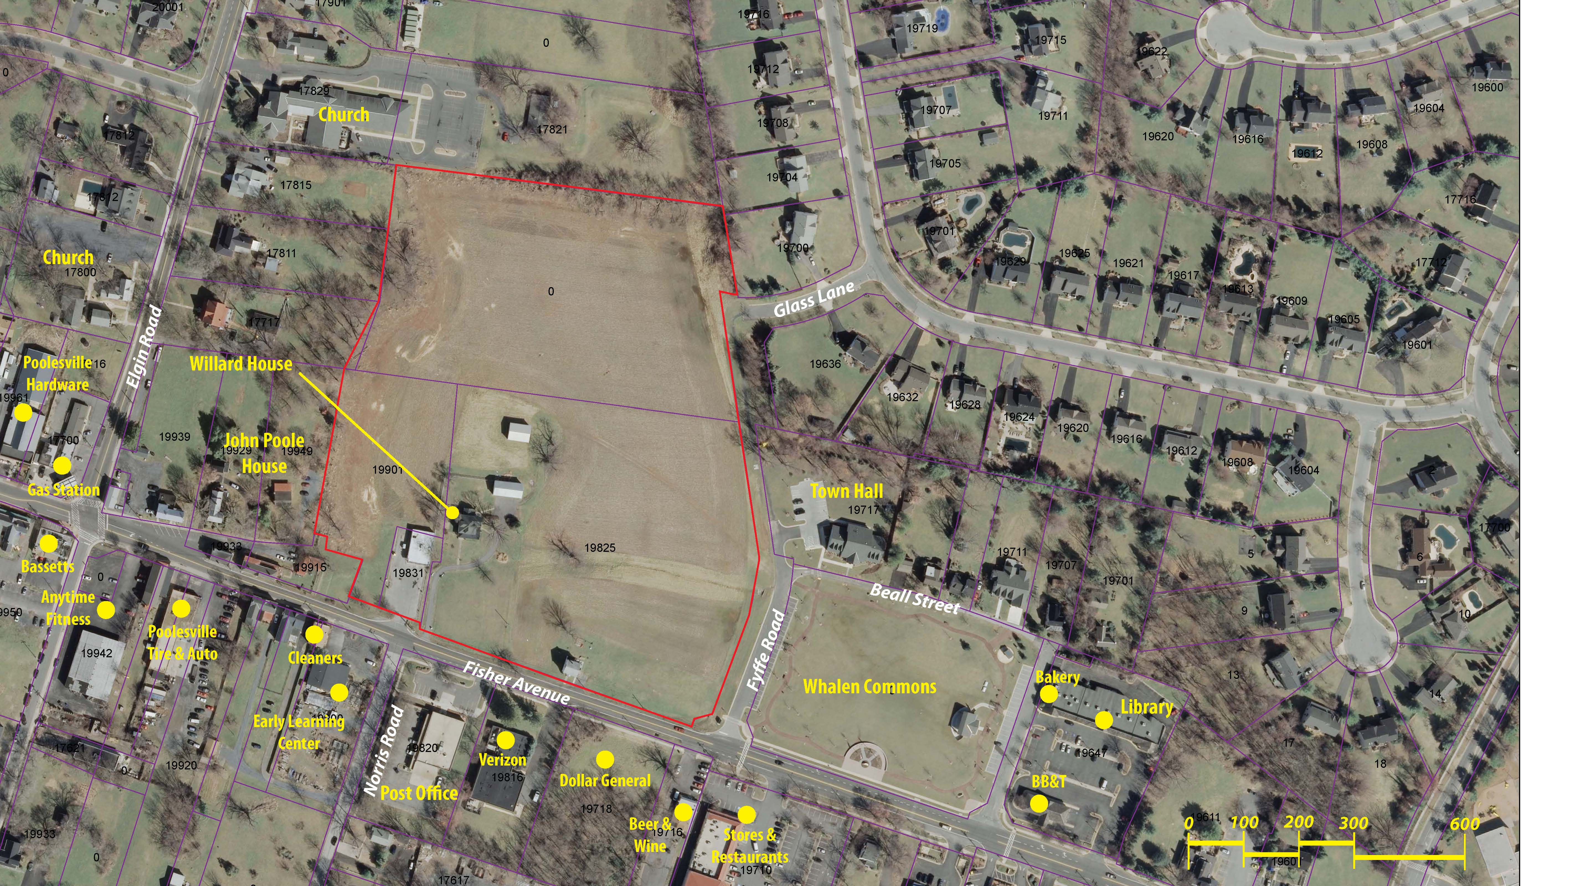

Slide 4
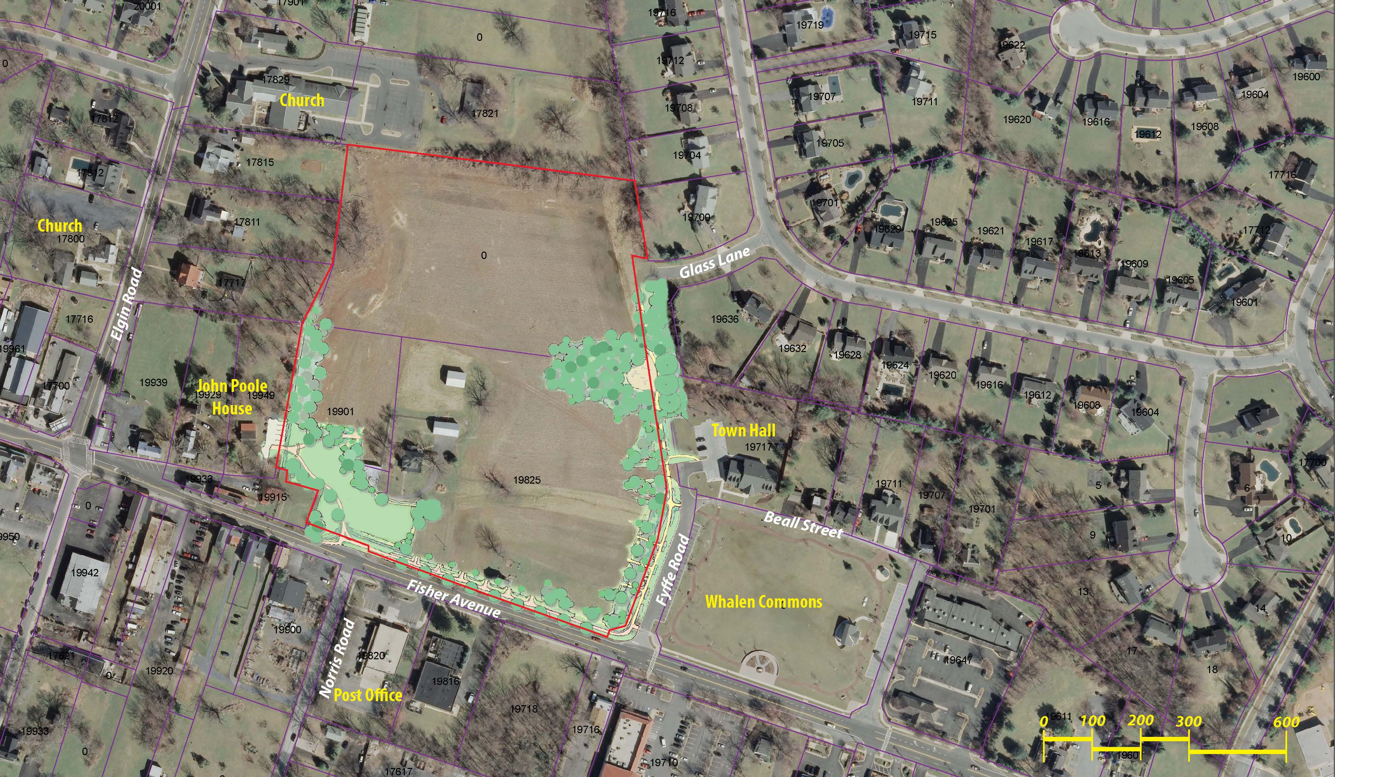
Parkland
1.4+/- ac. Required
1.4 +/- ac. Provided (Ded.)
Adj. to John Poole House
Promenade Connection to Glass Lane
Tot Park / Sitting Area along Fyffe Road
Viewshed to John Poole and Willard Homes
Pergola and Sitting Area
Tree-lined Walkways
Landscaping
Historic Markers
Notes:
Parkland: 1.4 ac required; previous 0.7 ac dedicated with 0.7 ac in-kind services; now: 1.4 ac dedication; Approx. 0.8 to 1.0 ac addition to J P House, and balance along Fyffe as linear park and expansion of Whalen Commons and ‘old’ Fyffe Road right-of-way.

Slide 5
Pedestrian Connection from Glass Lane and Beale Street
Perimeter Landscaping
Add’l Parking
Multi-Use Green
Pergola and Seating Area
Historic Markers
Pedestrian Connection from Fisher Avenue and Norris Street

Slide 6
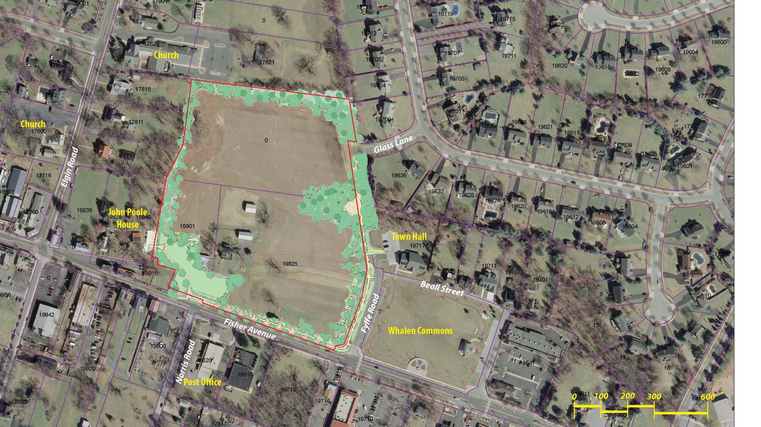
Forest
Up to 2 +/- ac. Required
Up to 1 +/- ac. Provided (On-site)
Balance Off-Site
Integrated Into Open Space
Buffer to Adjacent Properties
Near Existing Trees/Forest
Potential Landscape Enhancements in Parks

Slide 7
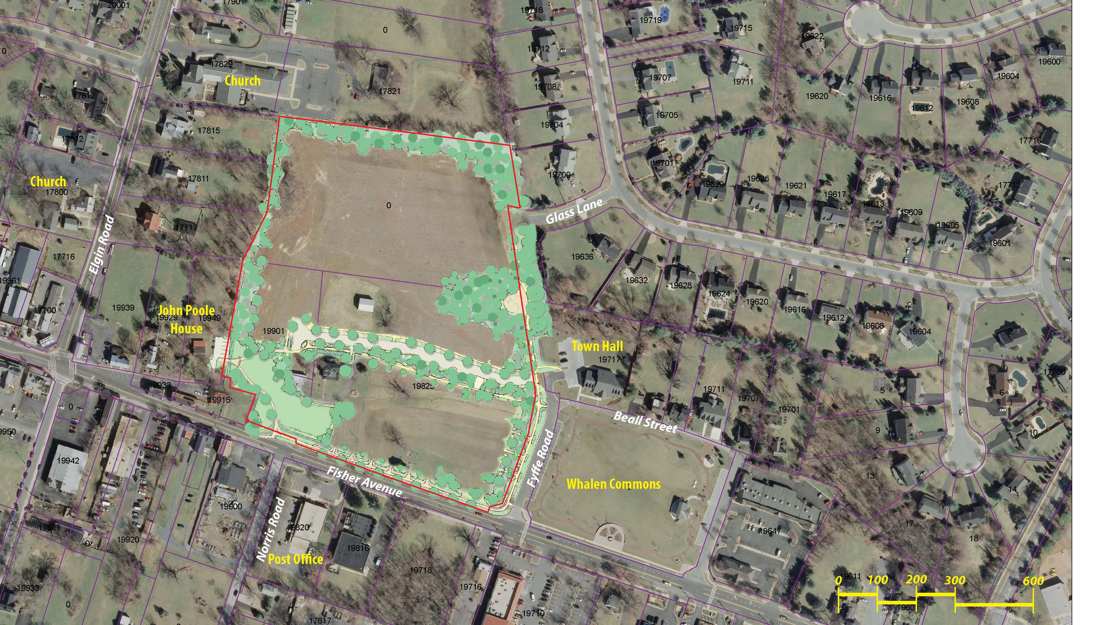
Pedestrian Greenways and Connectivity
Beall to John Poole House
Fisher to John Poole House
Fisher to Glass
Norris to John Poole House
Glass to John Poole House

Slide 8
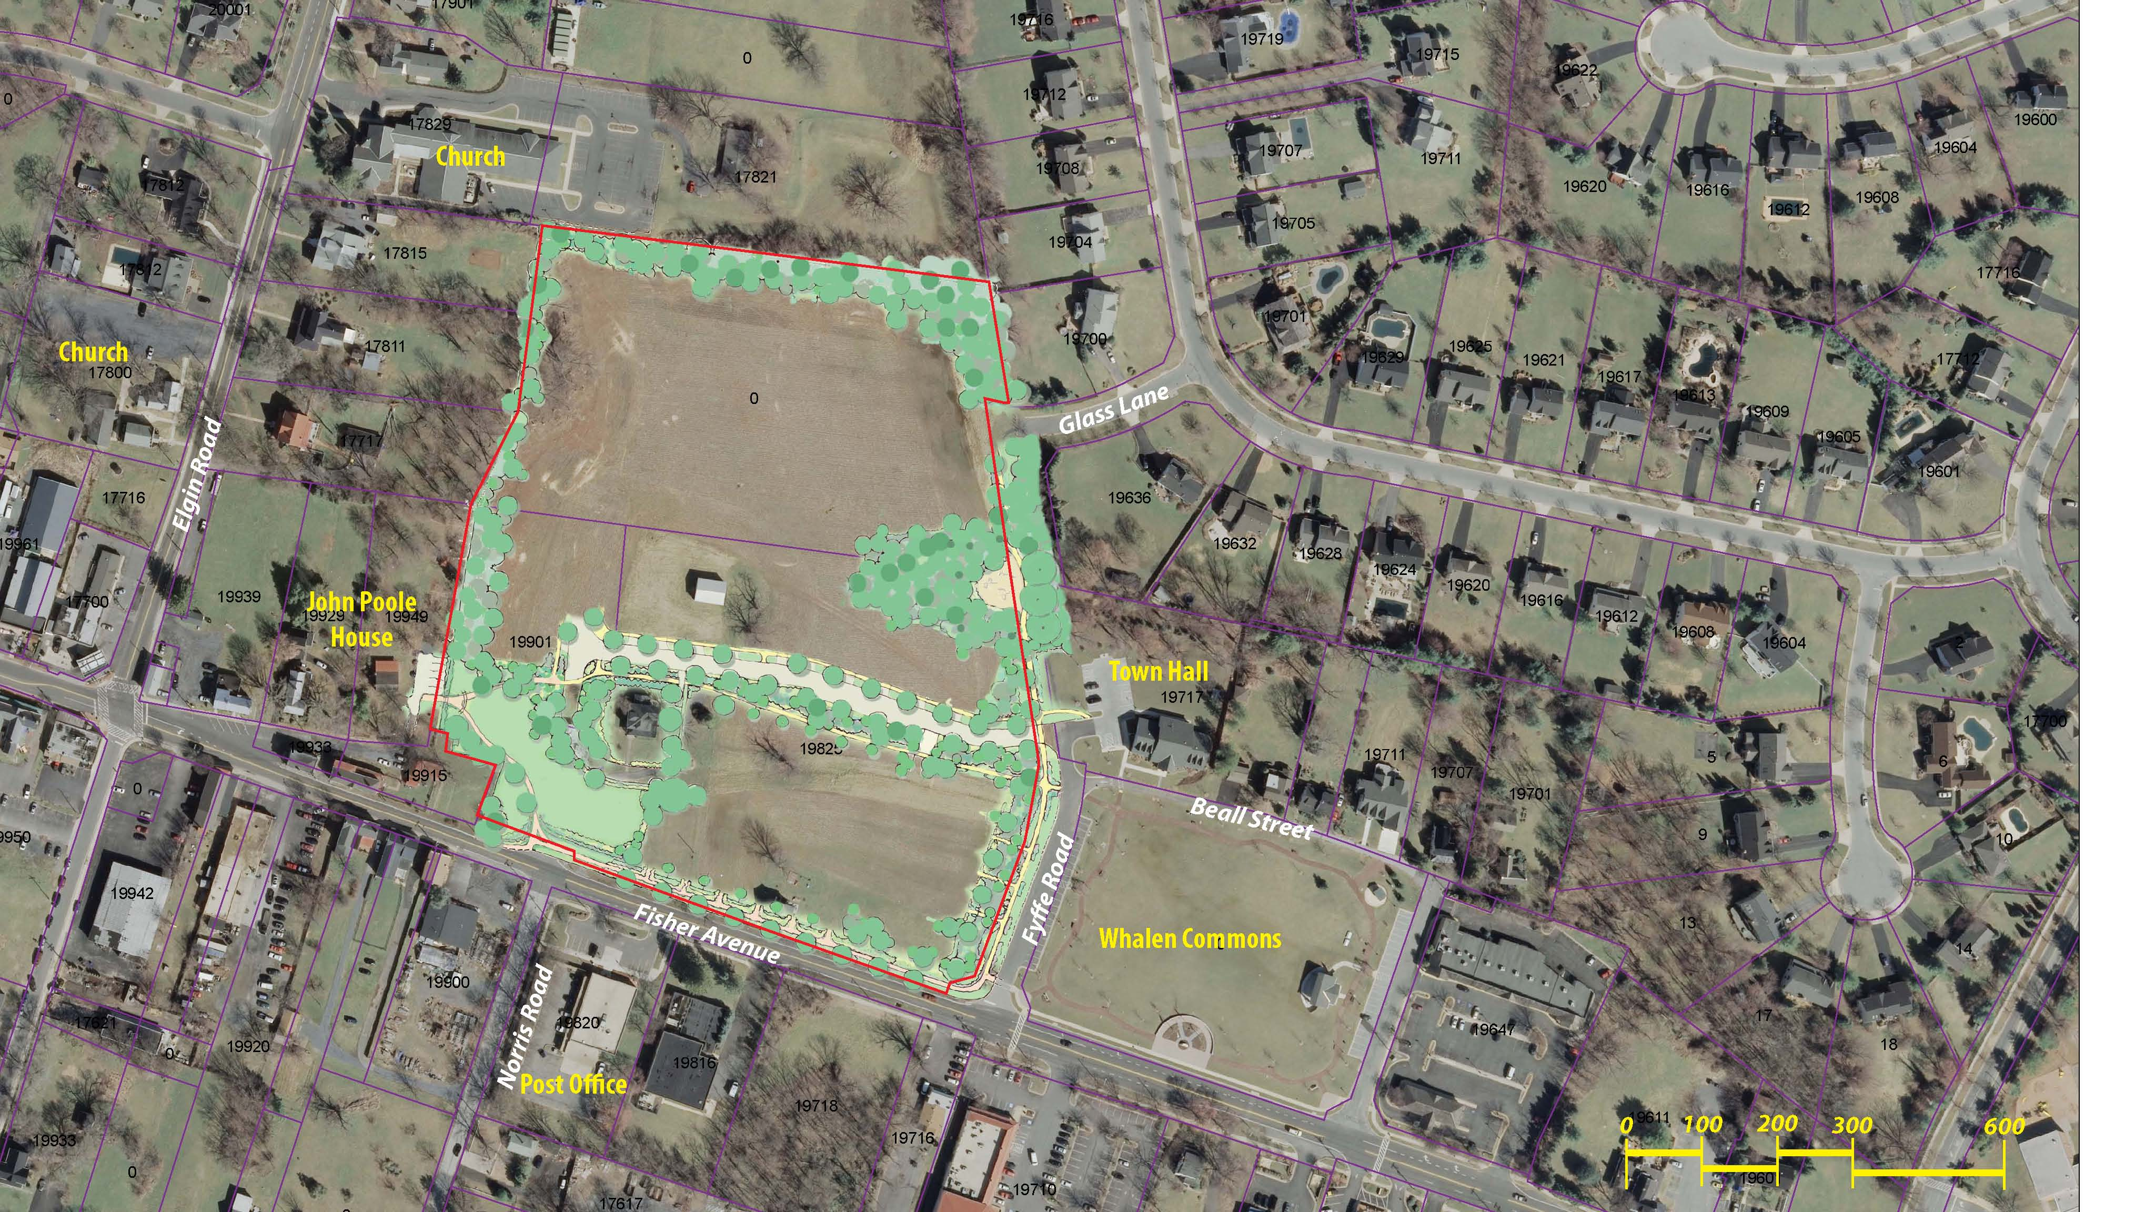
Willard House
Retained and Enhanced with Landscaping
Compliments Park and Home
Notes:
Enhanced Landscaping around the Willard House to complement Park and Home

Slide 9
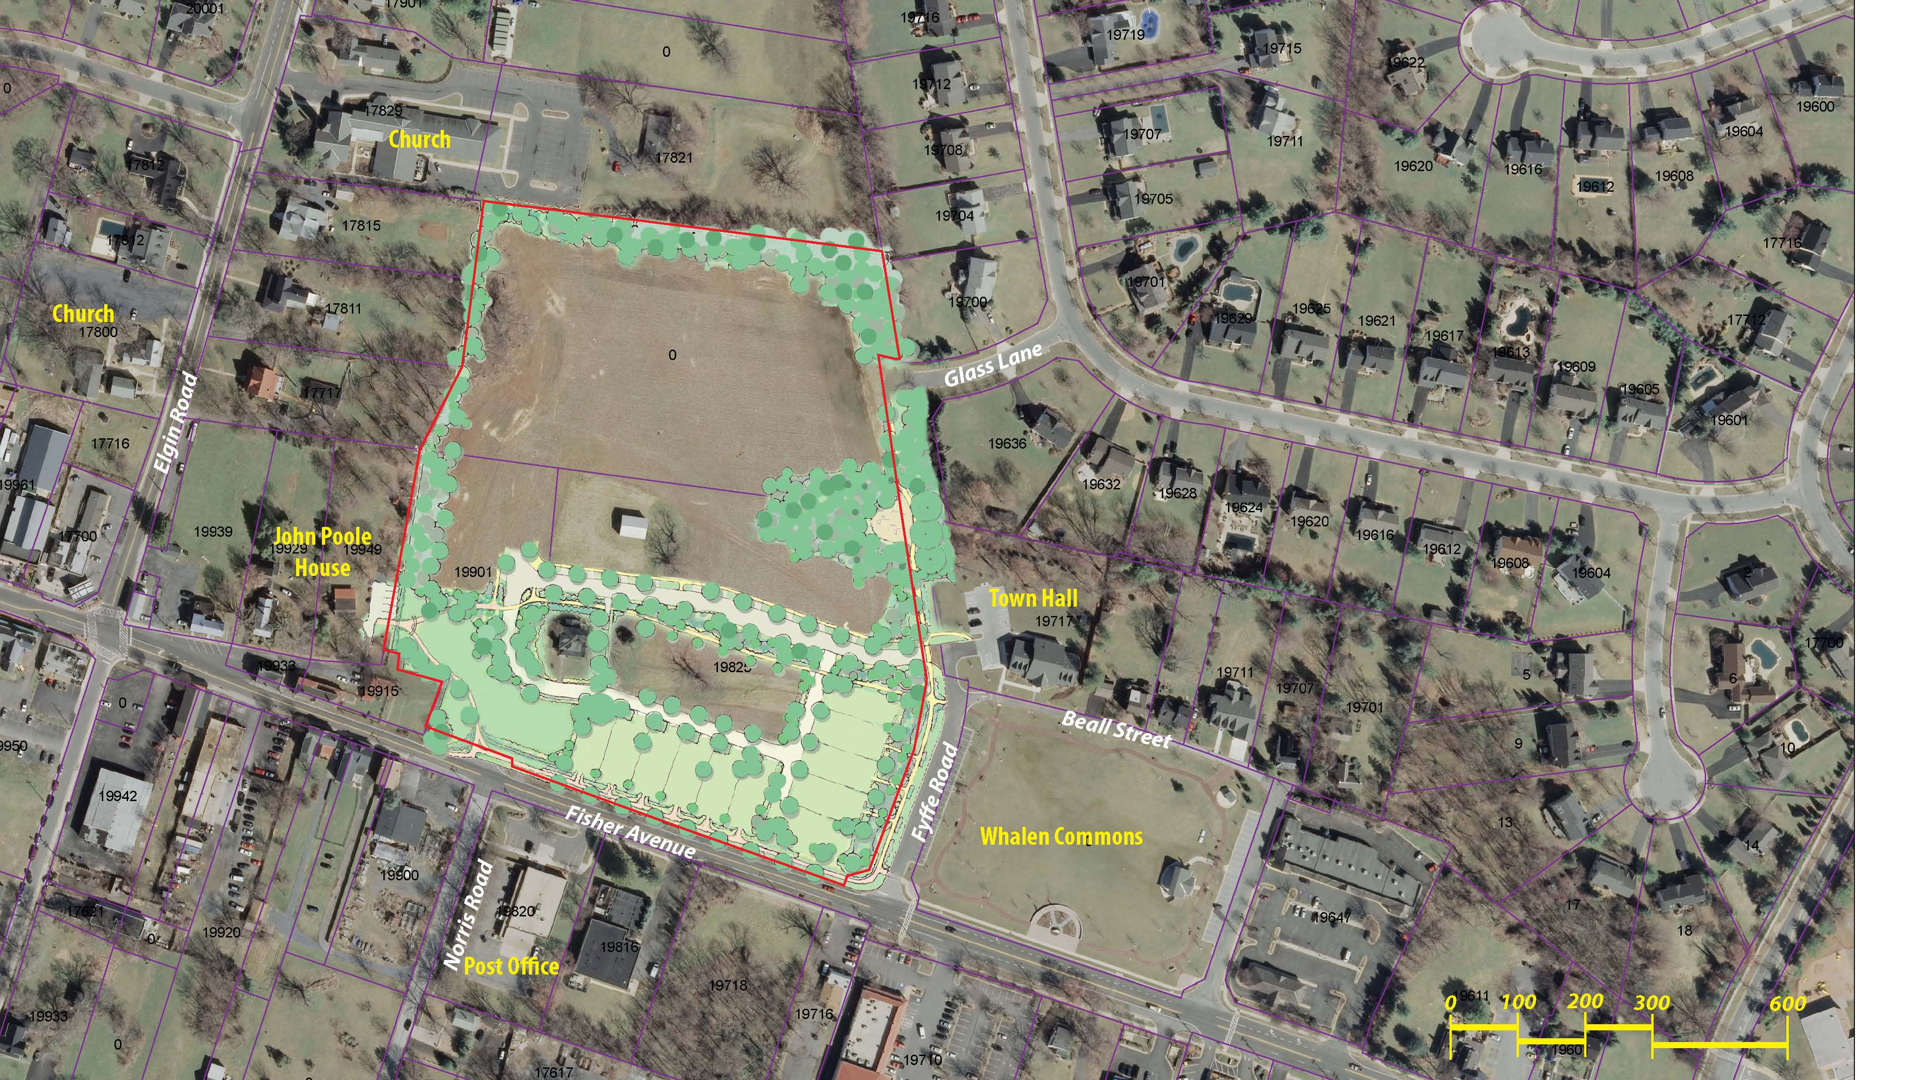
Fisher and Fyffe
Fisher Improvements Per Master Plan
Fisher Dedication and Widening
Streetscape
Homes Facing Each Street
25’ Front Setback
10’ Side Setback

Slide 10
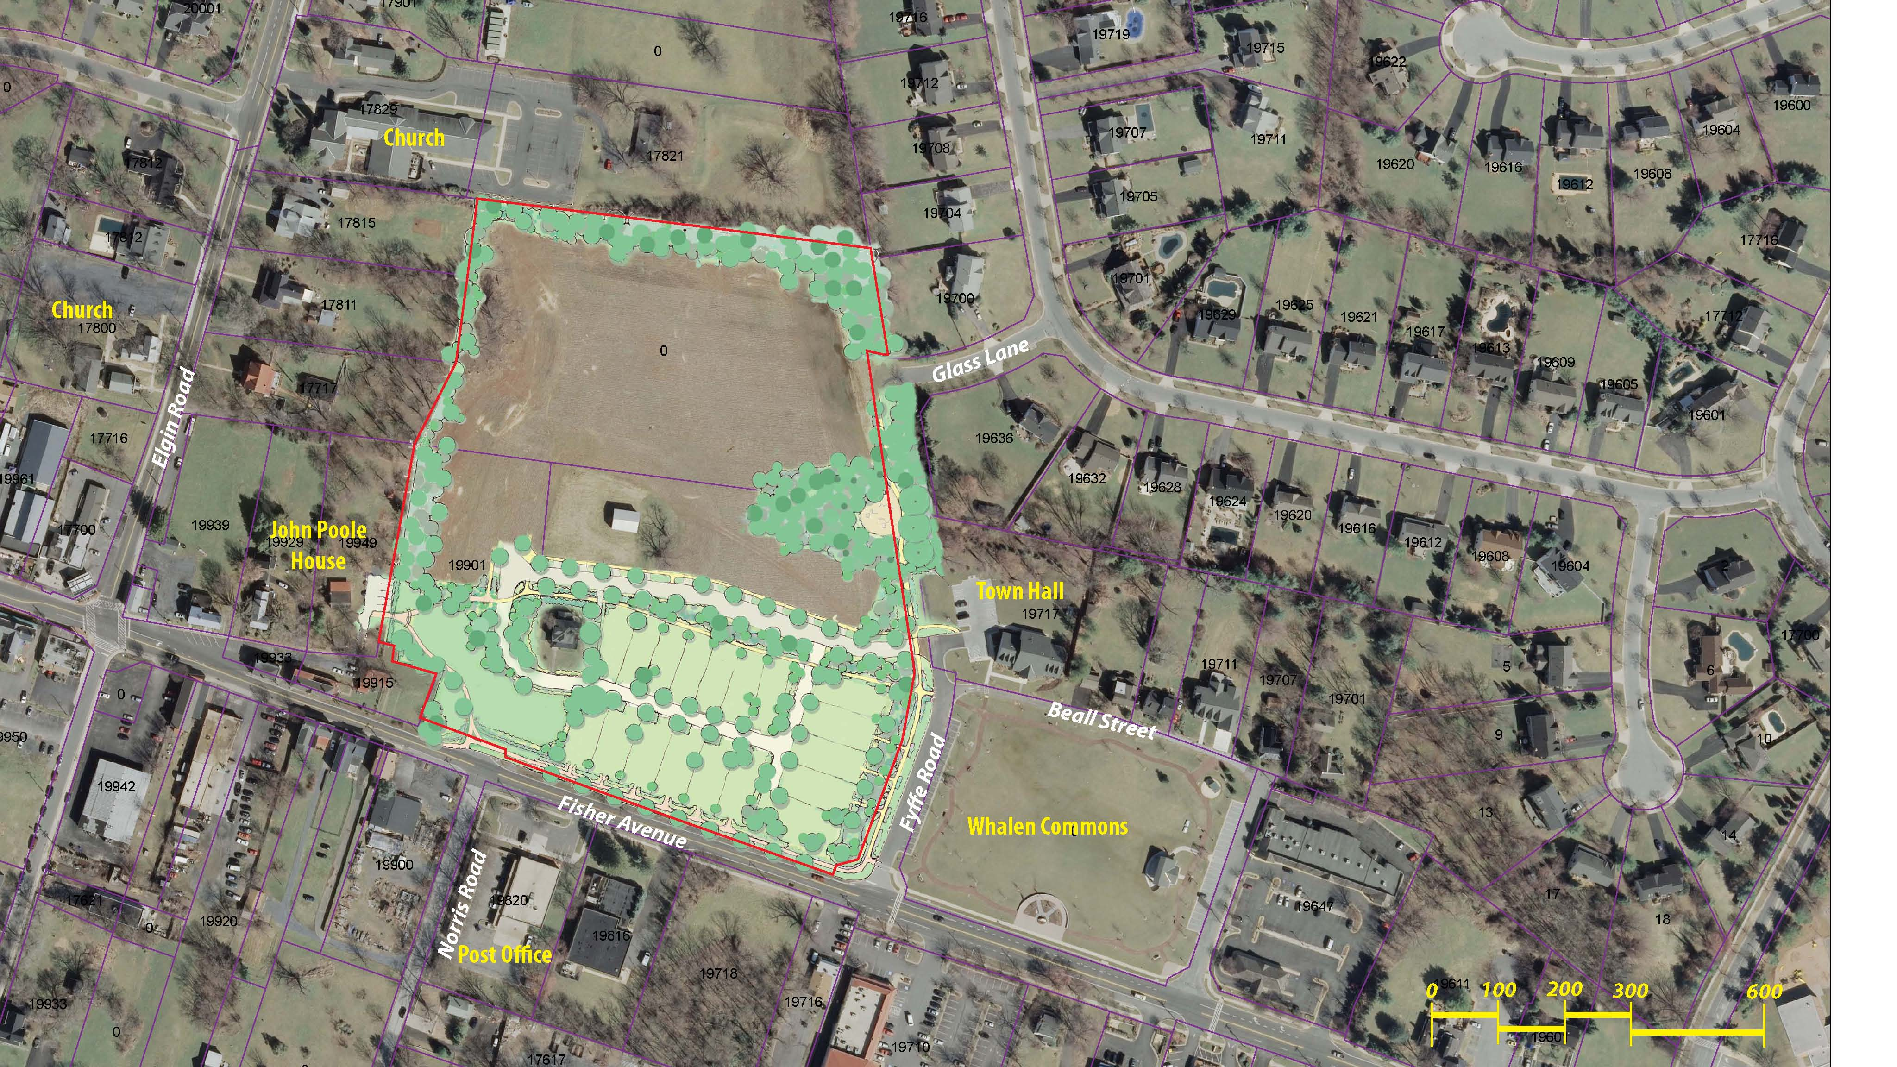
Fisher and Fyffe
Fisher Improvements Per Master Plan
Fisher Dedication and Widening
Streetscape
Homes Facing Each Street
25’ Front Setback
10’ Side Setback
Rear Loaded Homes / Screened Garages

Slide 11
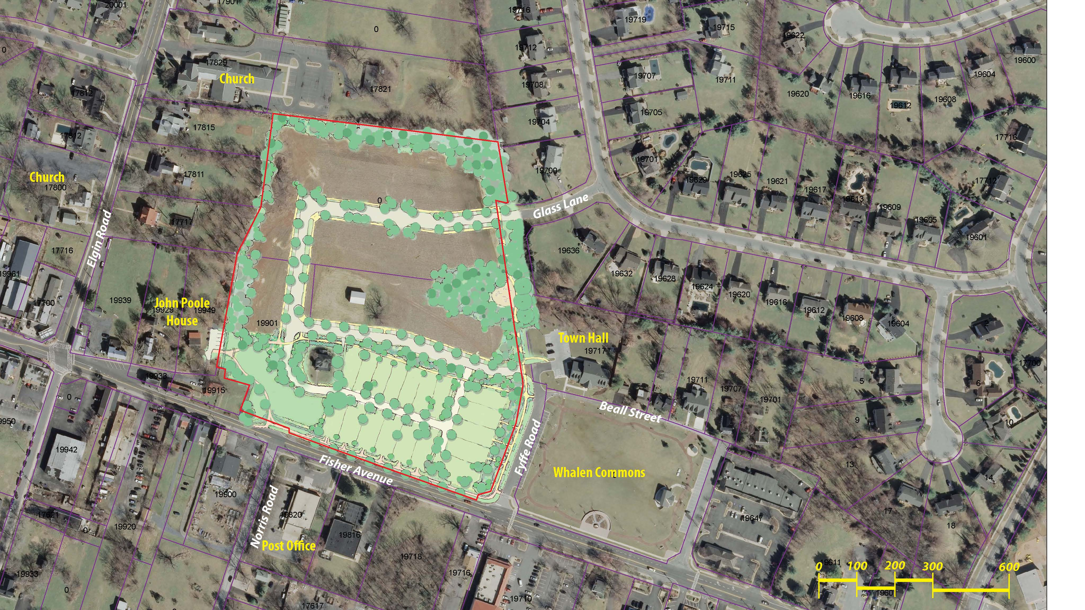
Glass Lane Extension
Indirect with Stop Signs
Slows Traffic
Provides Pedestrian Connectivity to John Poole House and Park

Slide 12

Open Space
Integrated Throughout Community
Provides SWM Opportunities
Provides Visual Buffering

Slide 13
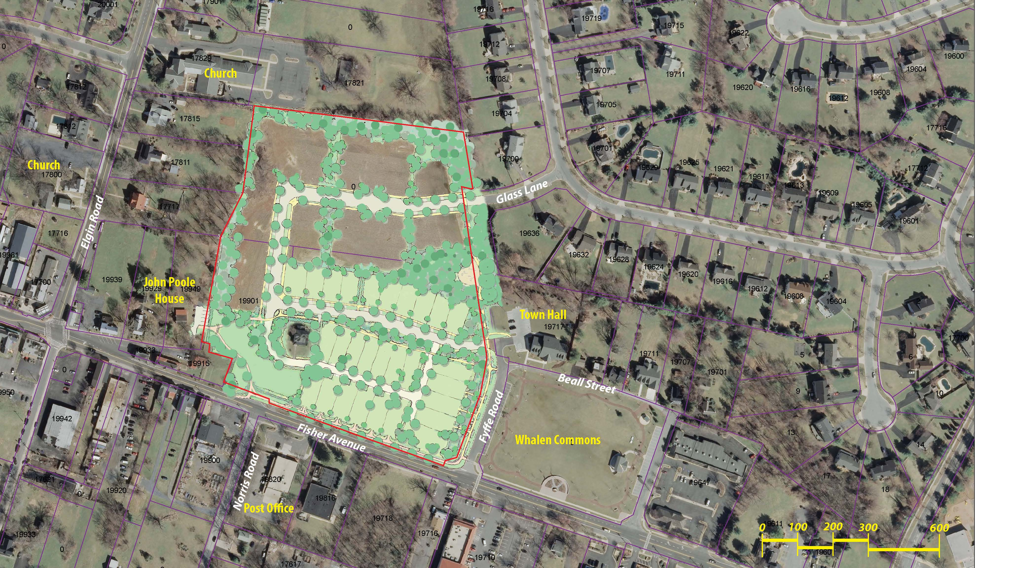

Slide 14
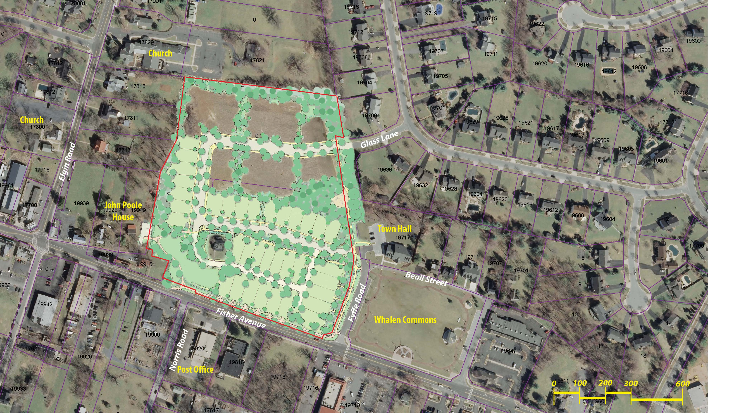

Slide 15
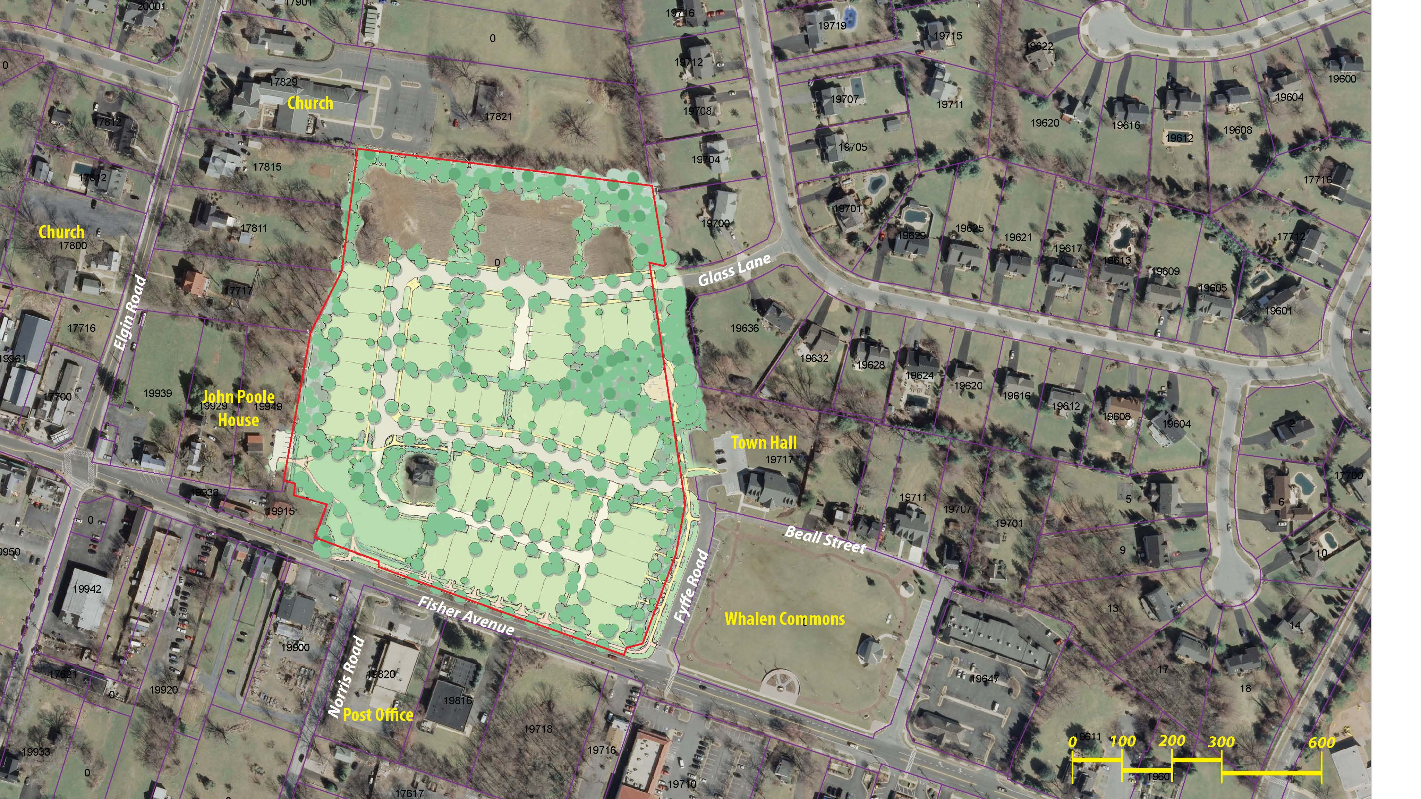

Slide 16
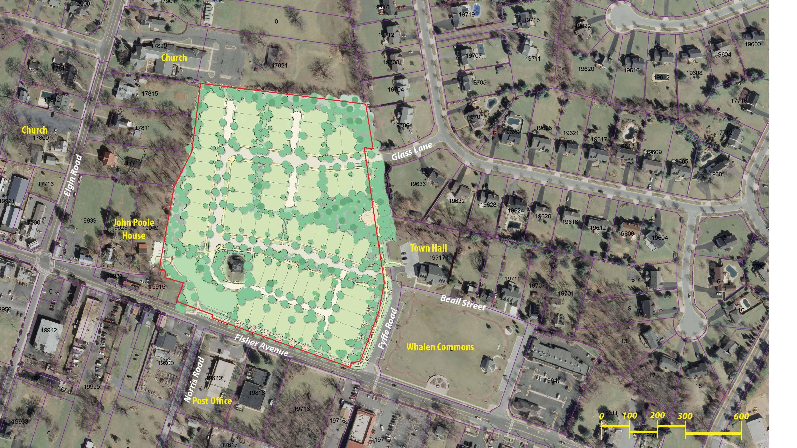

Slide 17
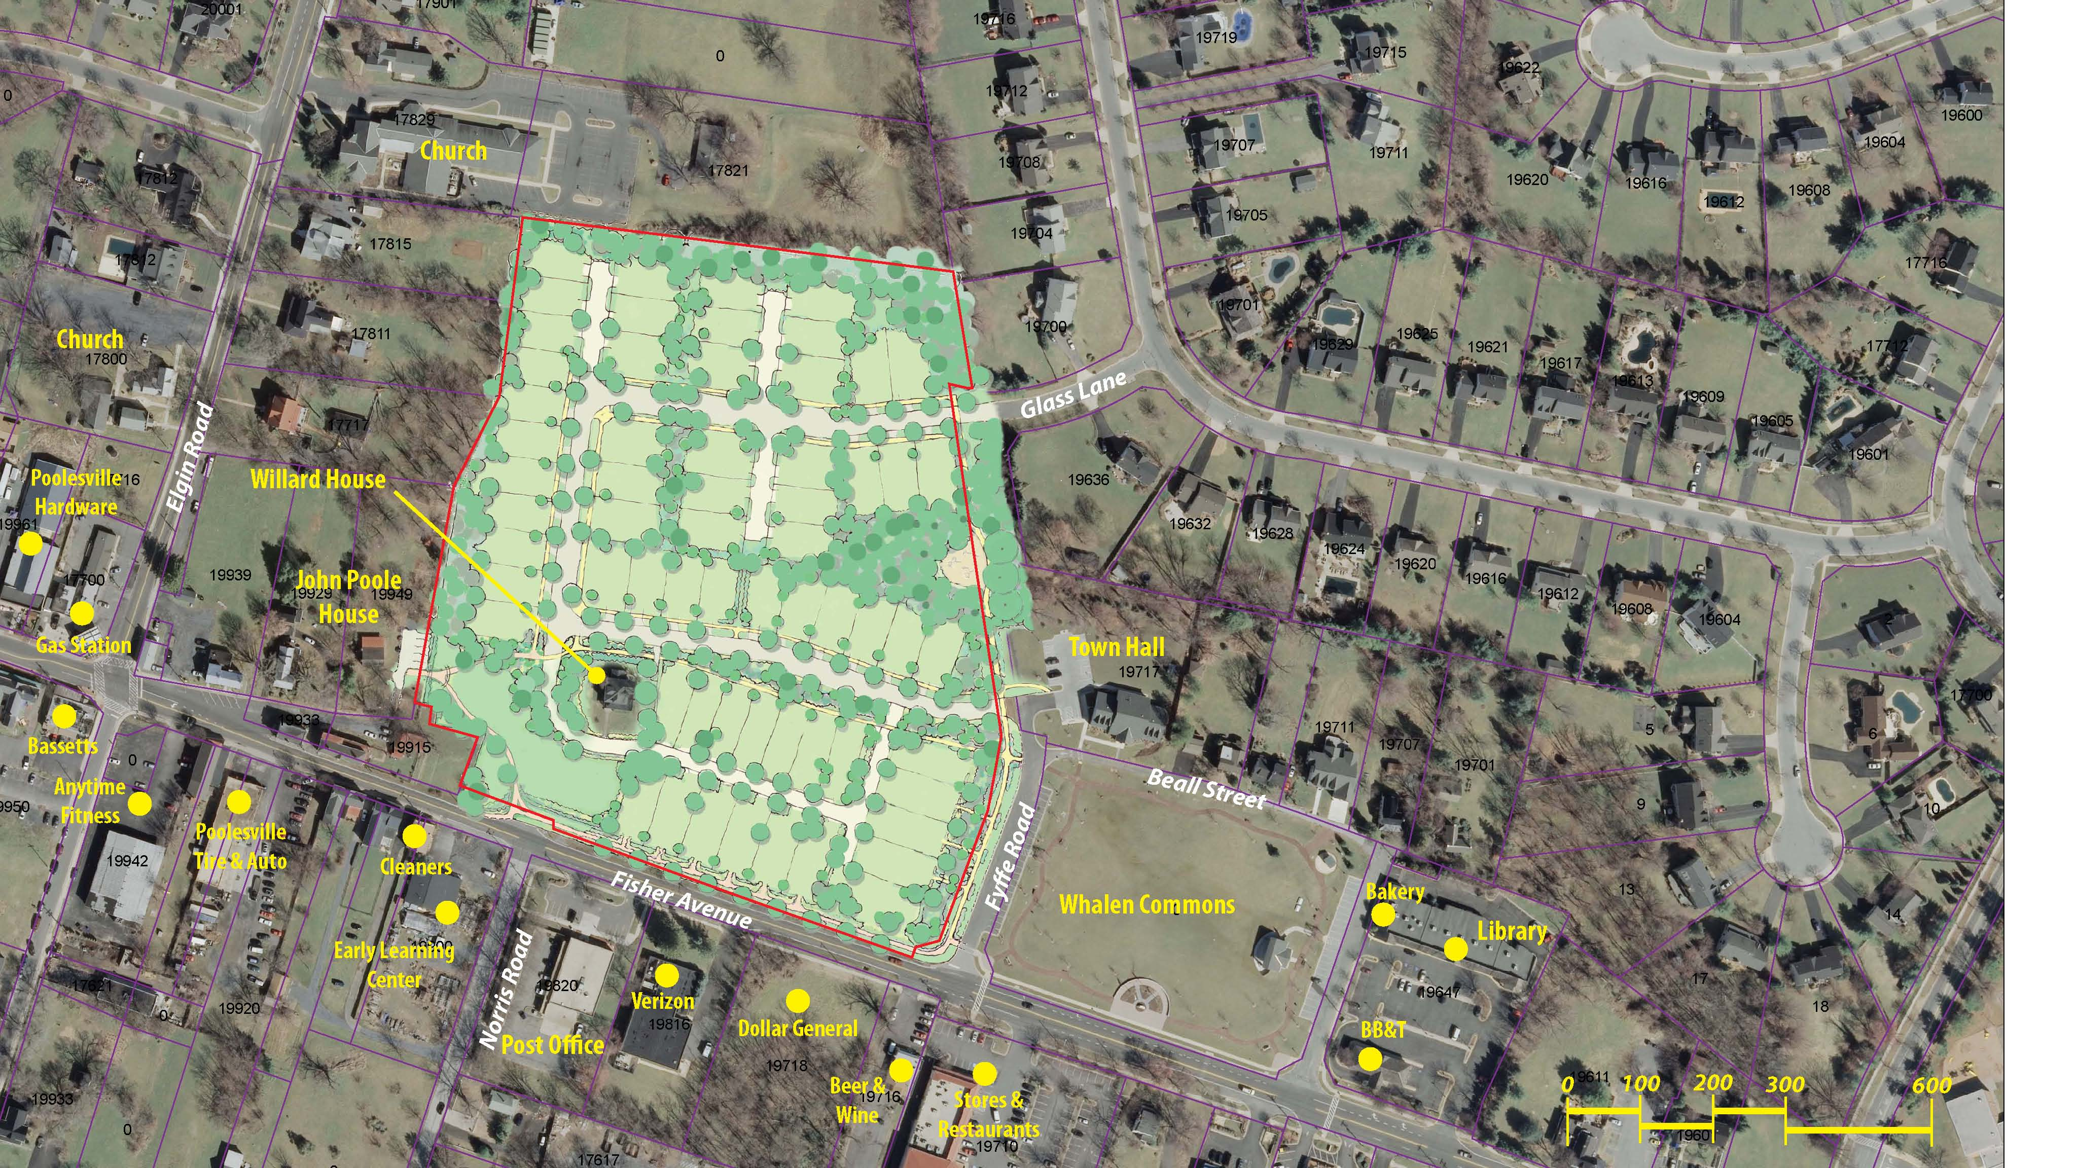

Slide 18
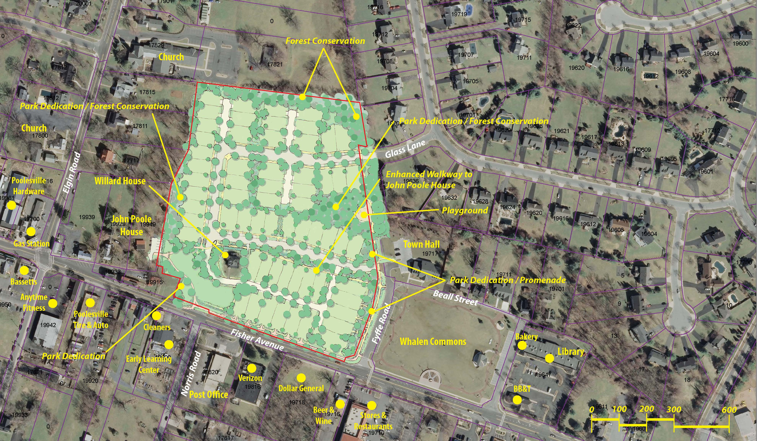

Slide 19
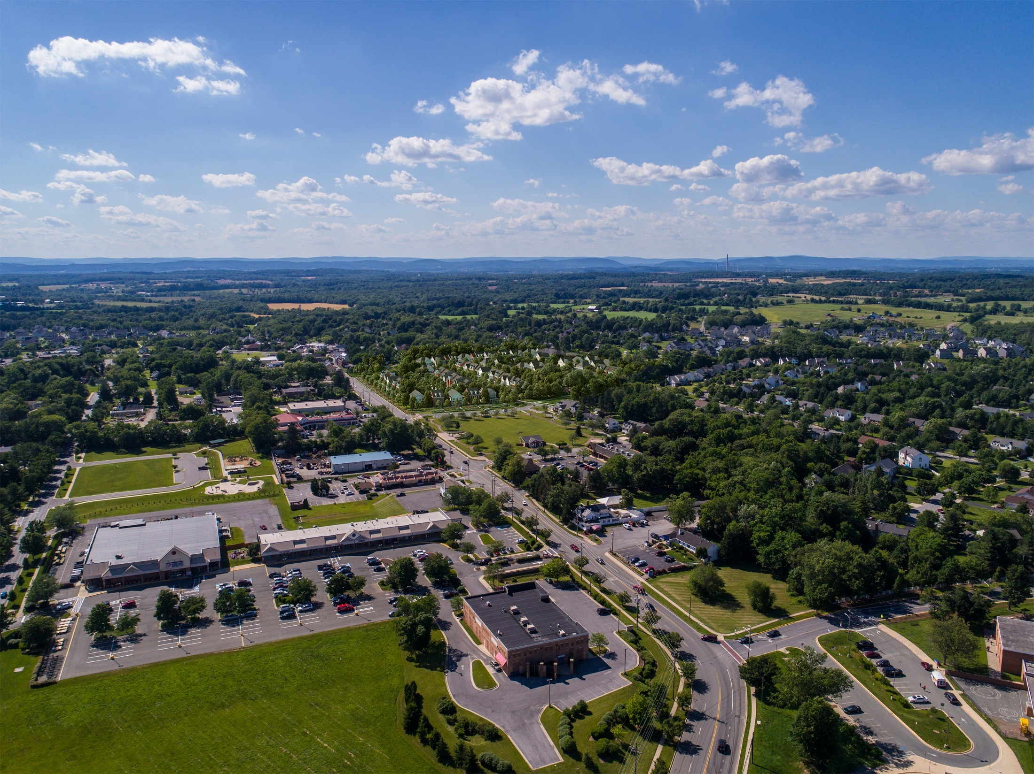

Slide 20
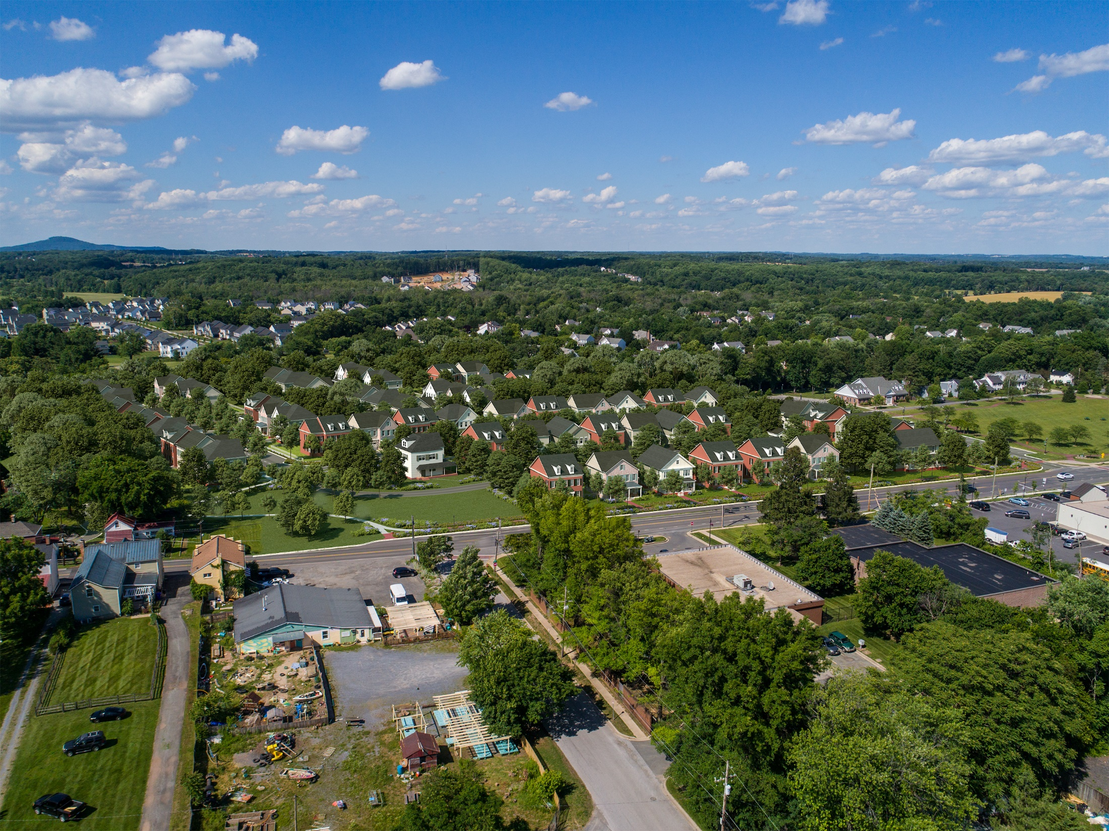

Slide 21
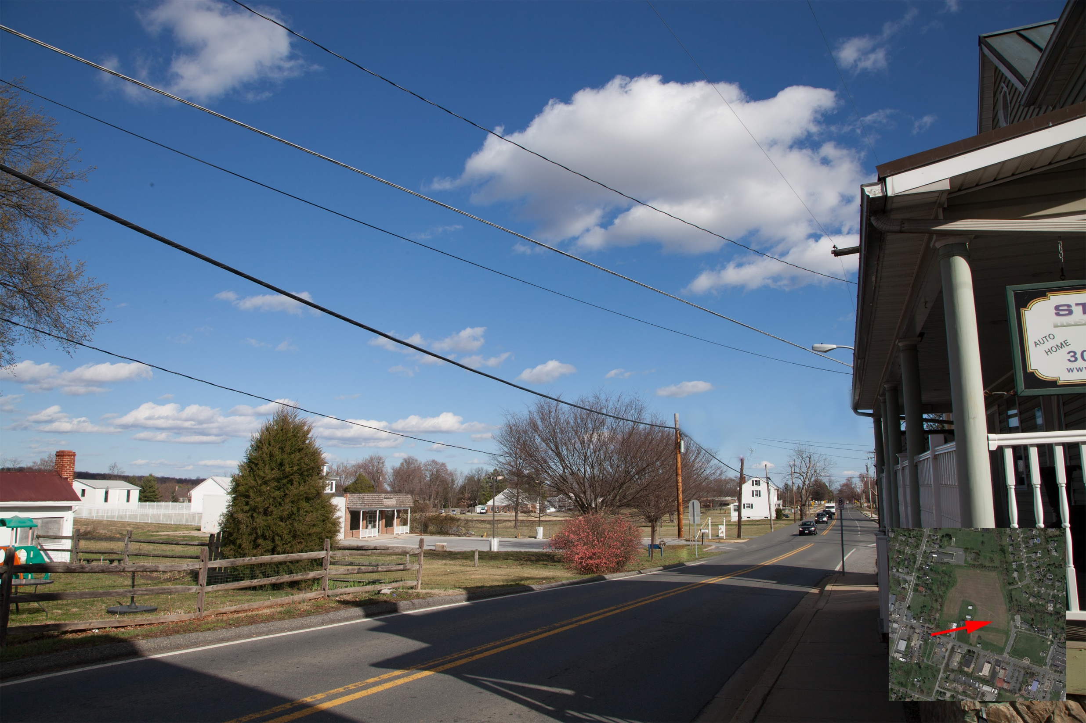

Slide 22
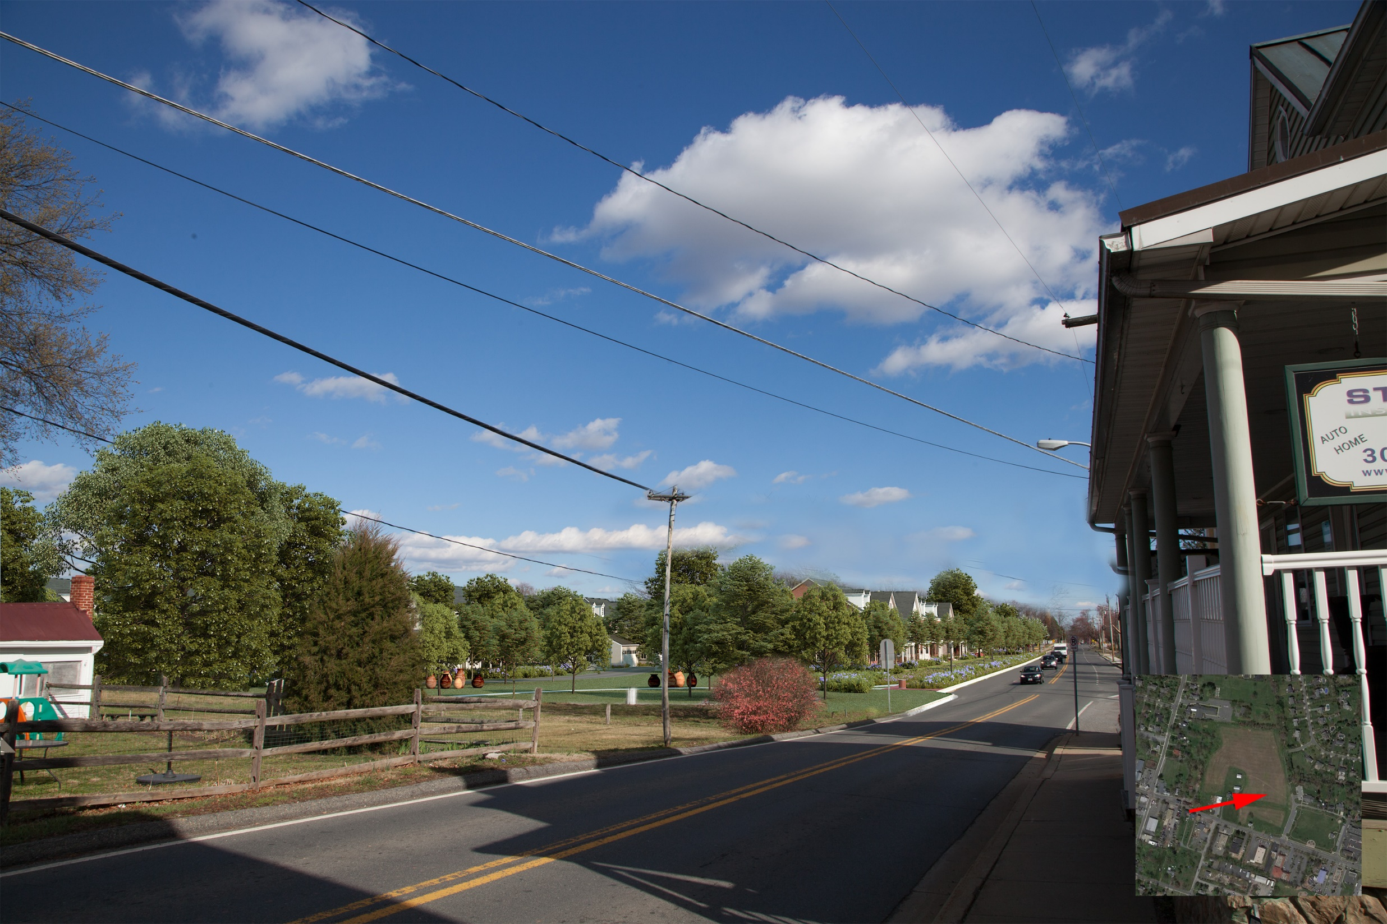

Slide 23
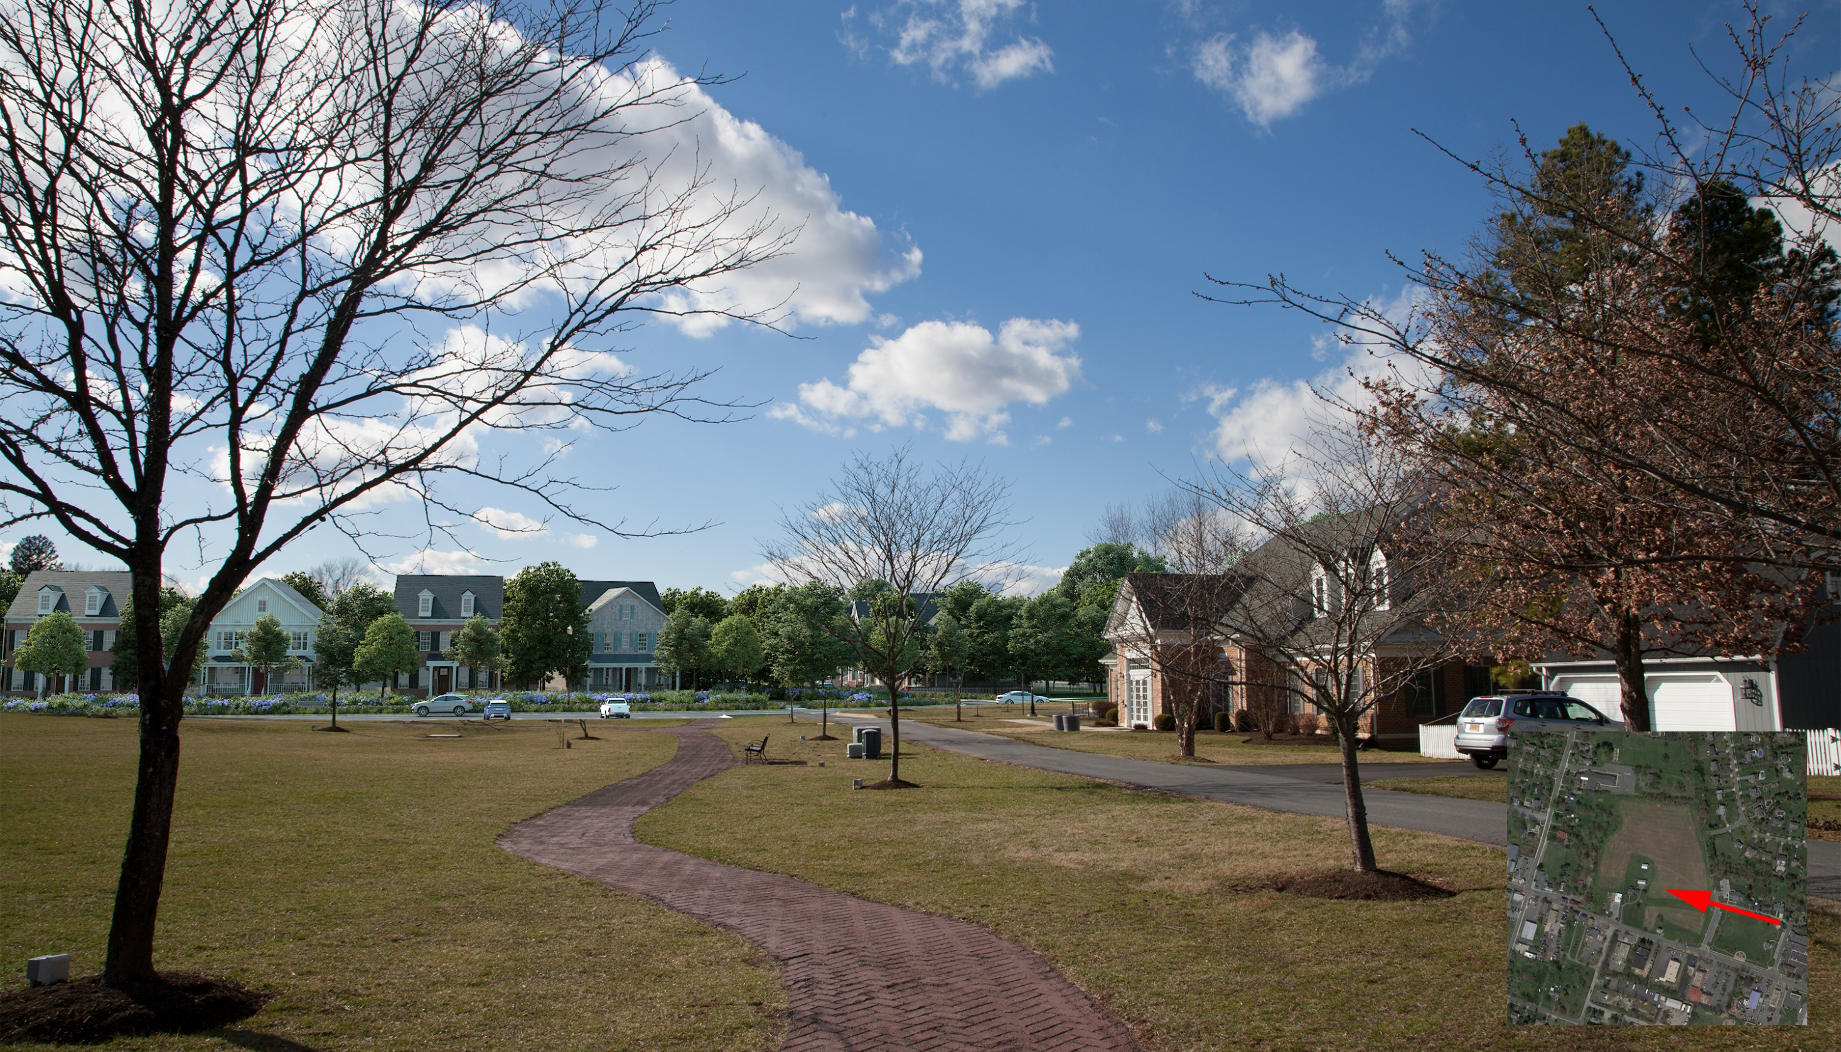

Slide 24
