Slide 1
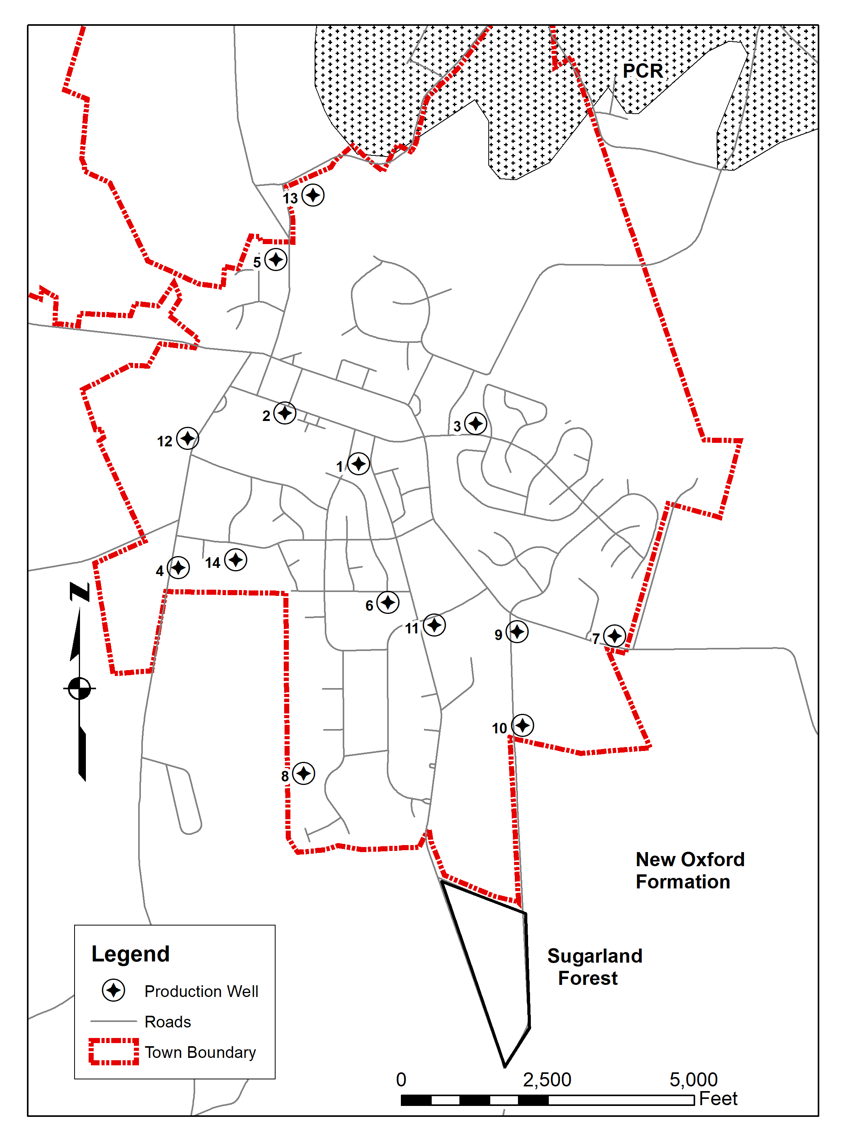
Poolesville Water Supply System History
Prior to 1969, residents were supplied by individual wells and springs.
Due to contamination by on-site septic systems, the State directed the town to develop a central public water supply in 1970.
By 1978 water use was 246,000 gpd avg and the yields of wells 1-4 had declined, which was linked to well interference
Well 5 was completed in 1980, and well 6 in 1985
Permitted water use was increased from 260,000 gpd avg to 580,000 gpd avg in 1986 to meet unspecified growth in the town. The increased amount of the permit (222 gpm avg) was apparently based on the tested yield of well 6 (225 gpm)
By 1996, the yield of well 6 had declined to 80 gpm.
In 1999, the town manager indicated that mandatory water restrictions were required during that drought, as well as the non-drought years of 1993 and 1995, with voluntary restrictions in a number of other years.

Slide 2
Poolesville Water Supply System History
(continued)
In June 1999, I met with the town and made suggestions that increased the total yield of the system by more than 200,000 gpd, mainly by increasing the yield of well 2 from 20 gpm to 100 gpm, and increasing the pumping periods of the individual wells from 16 hr/d to 20±hr/d.
Subsequent data suggested that the yields of wells 6 and 7 were over-estimated and damaged by excessive dewatering of upper reservoir units, substantially reducing their yields.
The town indicated that it only needed 480,000 gpd avg to meet existing water demand. Normally, this would result in a reduced appropriation, but, due to the increased system yield, the permit was nominally reduced to 550,000 gpd to meet existing demand and unspecified town growth.
With the additions of wells 9-14, the total of town’s water use appropriations was increased to the present 650,000 gpd/avg.

Slide 3
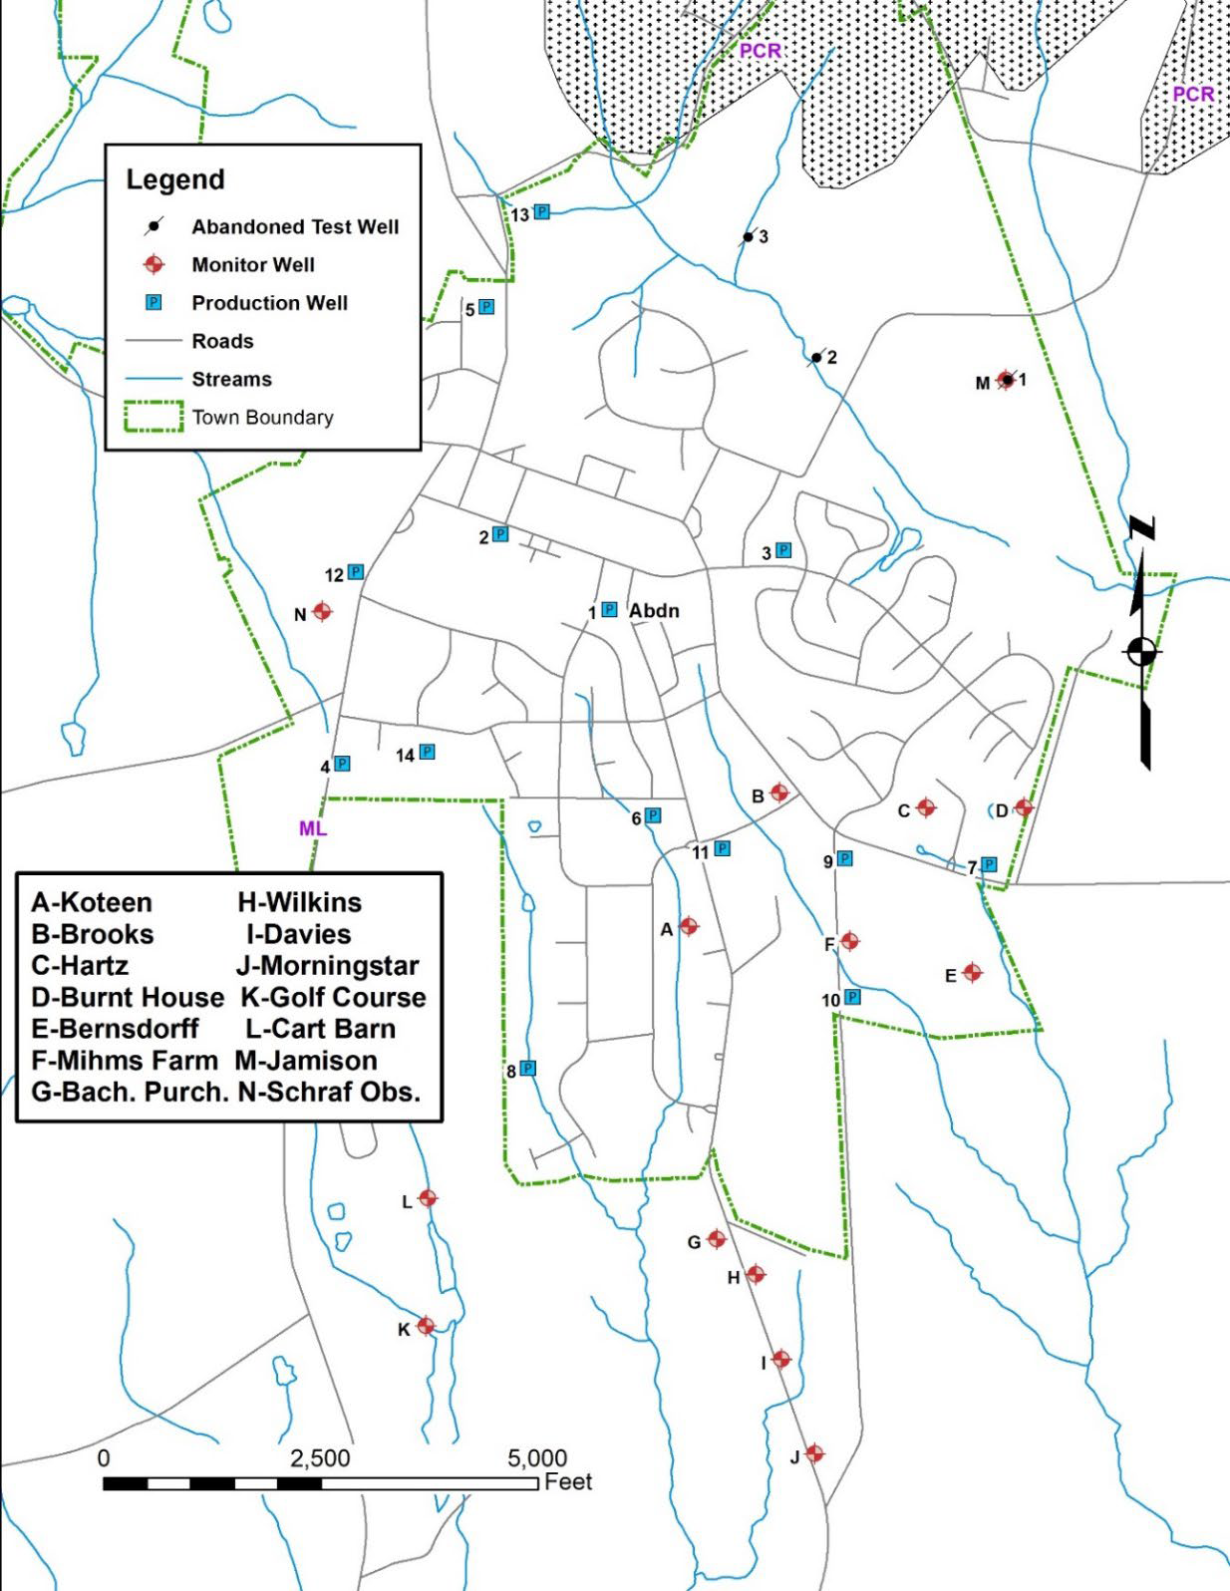
Poolesville’s withdrawals Interference Impacts
The first potential interference impacts to private wells due to Poolesville’s municipal withdrawals occurred in 1973, when 10-15 private wells were impacted after completion of the third town well and the State directed replacement of those wells by the town.
Multi-well tests of wells 4 and 5 (including monitoring of private wells) were conducted indicating impacts to nearby wells may occur, so those homeowners were given the option of being hooked up to the public system.
Multi-well tests of wells 6, 7 and 8 were conducted, but there is no known record that use from those wells impacted private wells.
In 1999, a multi-well test was conducted on a proposed municipal well at the Bachelor’s Purchase property. Drawdowns in nine observation wells along Hughes Road varied from 2 to 12 feet, and a 10th well went dry, with 23 feet of drawdown. The town abandoned the project due to a low well yield and the potential impacts to nearby house wells.

Slide 4
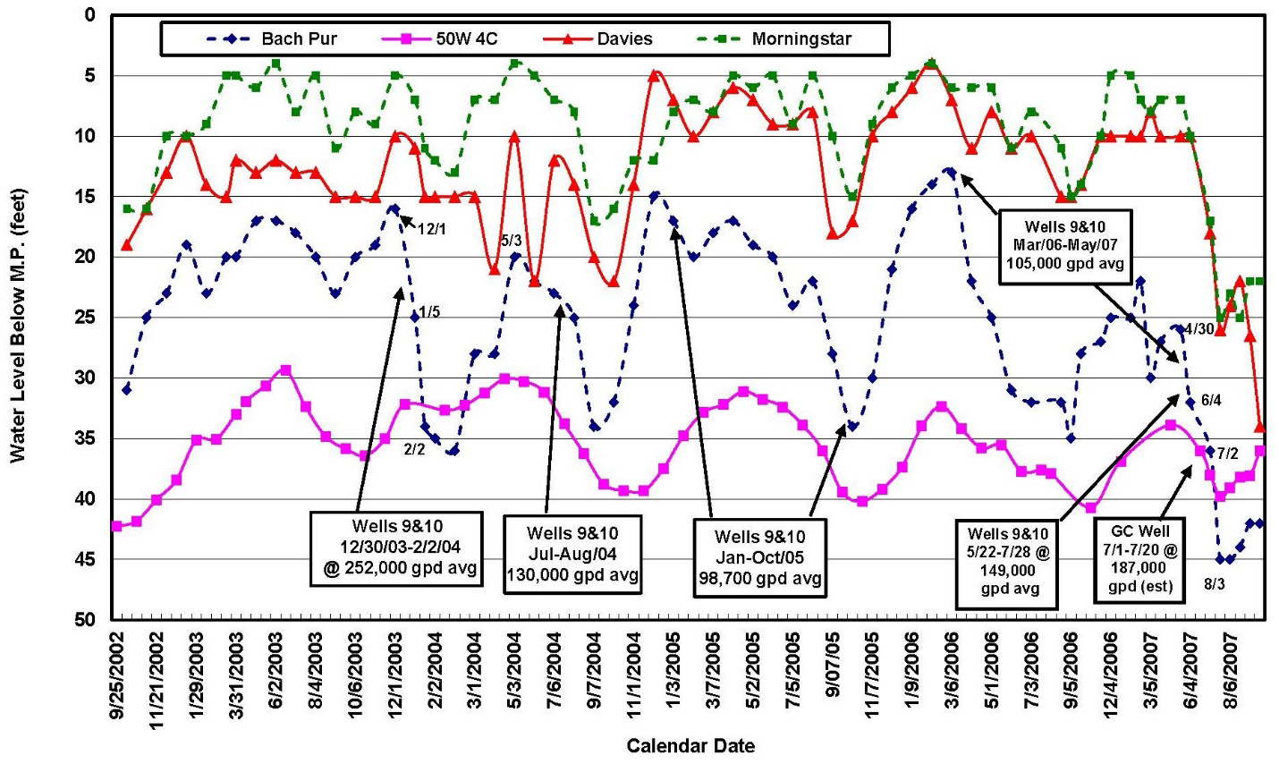
Interference Impacts Wells 9 & 10
Multi-well aquifer tests were performed on Poolesville wells 9 and 10 in 2001, under average climatic conditions. Six domestic wells within ¼ mile of wells 9 and 10 were replaced by the town and public water was supplied to a nursery.
Monthly water level monitoring, as shown on this graph, was required for four domestic wells and the inactive Bachelor’s Purchase well to see if impacts would occur in the Sugarland Forest community, about one mile south of town wells 9 & 10.
In August 2007, MDE received complaints that five house wells in the Sugarland Forest community had problems associated with low water pressure, turbidity or dry wells.
MDE investigated and determined the impacts were due to withdrawals from Poolesville’s wells 9 and 10, and the nearby Poolesville Golf Course irrigation well. The town and golf course paid for deep wells to replace the relatively shallow Sugarland Forest private wells.
After multi-well aquifer tests of wells 12 and 13, MDE identified properties requiring immediate replacement wells and those requiring long-term water level monitoring and possible well replacements.

Slide 5
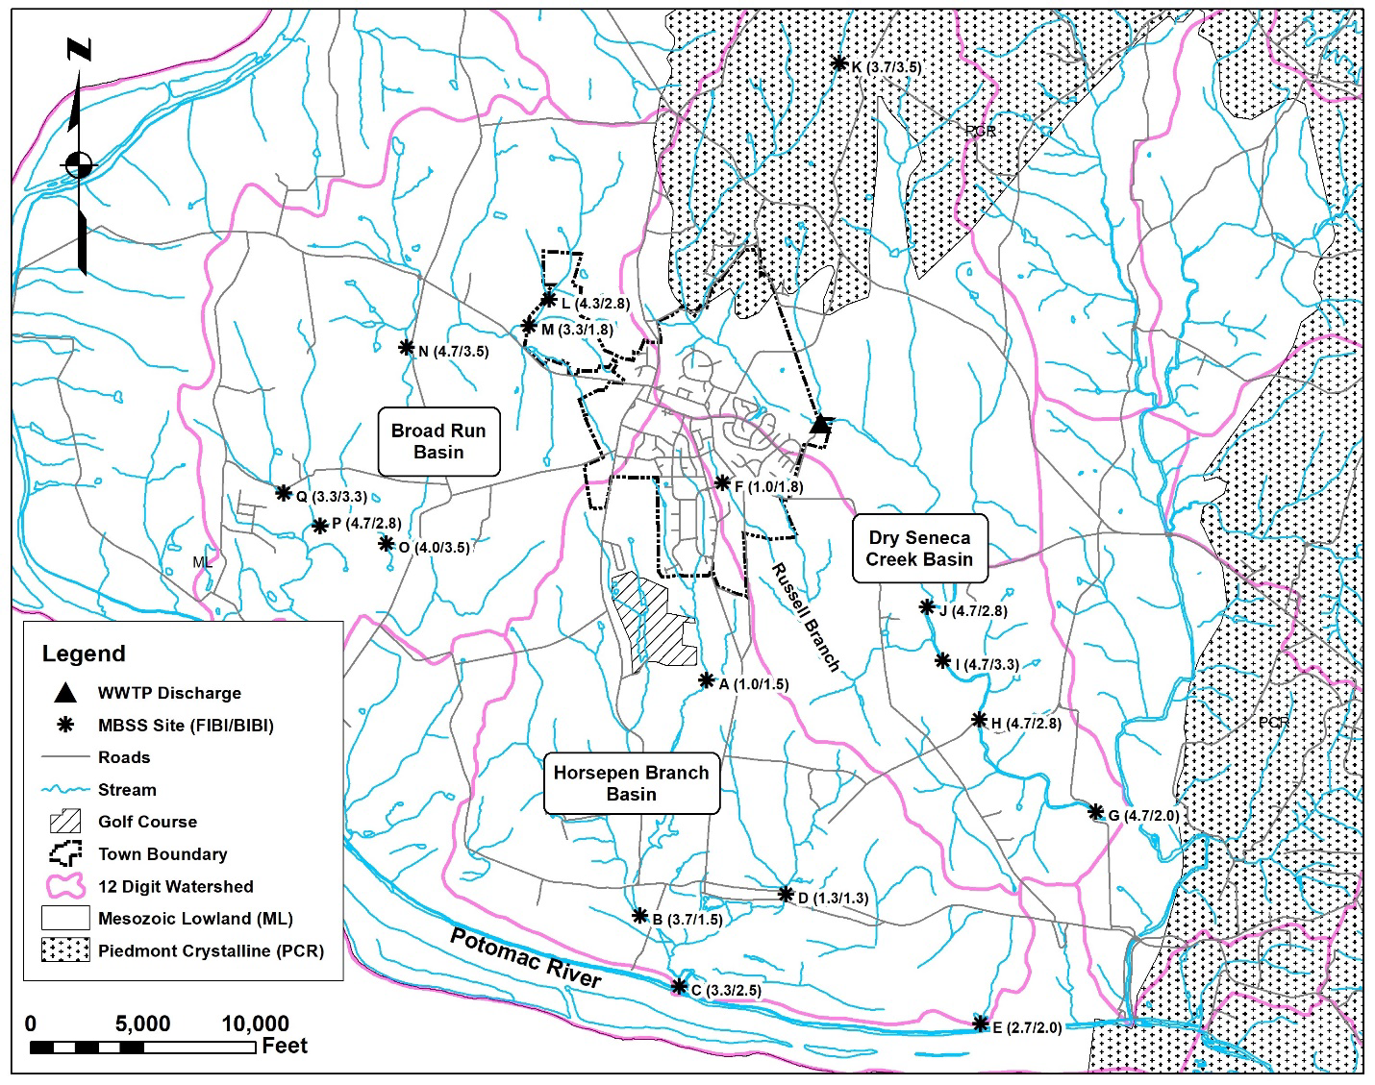
Impacts to streamflow, fisheries communities and aquatic habitat
In 1999, the water balance for the Horsepen Branch watershed indicated the town had an over-allocation of 155,700 gpd avg under its permit of 293,000 gpd avg. (recent use is only a maximum of 185,000 gpd avg). MDE notified the town on 11 May 1999 that it was allowed to over-appropriate water in the watershed to meet existing demand, as long as it caused no unreasonable impacts.
Horsepen Branch Site A is the most upstream MBSS site in the watershed (D.A., 774 ac) and is severely impaired (BIBI-1.50-Benthics, FIBI-1.0-Fish). Scores at or above 3.0 are considered to be unimpaired. Flows appear the have been reduced by more than 50% due to Poolesville’s withdrawals on the sample date (7/9/2008, a climatically above average year).
The stream could be restored by using excess water balance capacity and additional wells in the Dry Seneca Creek and Broad Run watersheds. That should be sufficient to supply existing demand, and depending on well yields, future growth.

Slide 6
The Effects of Climate Change on Poolesville’s Public Water Supply
Water Demand
Estimated average annual demand is 669,550 gpd avg
for a grow-out population of 6500.
Average reported use 2018-2023 = 530,942 gpd avg Existing population = 5772
Occupancy rate was 97%
Added are 728 people at 100 gpcd,
10% for drought and
5434 gpd avg for 30 days at 100 °F
Maximum monthly demand is 1,003,484 gpd max
(max/avg ratio of 1.5:1)
Reported use during 2007 (dry, below average climatic year)
Max/avg ratio = 1.4:1
Maximum monthly demand = 937,370 gpd
and 66,114 gpd added for 30 days at 100 °F

Slide 7
Methods Used to Estimate Well Yields in Fractured Rock Aquifers
Data taken from semi-log plots (log time versus linear drawdown) of the various aquifer tests conducted on the Poolesville’s public water supply wells. Upper graph Well 6 test and lower graph Well 7 test.
Breaks in the drawdown data (deviations from type curves) were used to estimate the depths to reservoir units. Example, Well 7 break at drawdown = 228 feet. Drawdowns from type curves are extrapolated to 90 days.
The calculated specific drawdown at that point is applied to the drawdown to the reservoir unit to determine a well’s estimated yield.
The result is then adjusted for a drought yield using a method developed by MDE.
Yields are then corrected for well interference. (2 and 12, and 9 and 10, but not well 11 with wells 6, 9 and 10, and 14 with well 4)
The damage to wells 6 and 7 due to dewatering of reservoir units is included.

Slide 8
Poolesville Total Well System Yield to Meet Maximum Monthly Demand = 750 gpm Using MDE Method for Estimating well Yields, Adjusted for Drought, Corrected for Well Interference and Water Balance Limitations

Slide 9
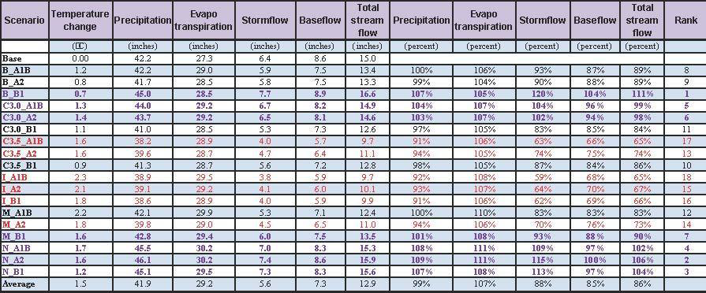
ICPRB Climate Change Scenarios (2040) Upper Potomac River Basin
This ICPRB table contains averages of annual precipitation, evapotranspiration, stormflow, and baseflow for the base scenario (1988-1999) and 18 climate change scenarios ending 2040 for the upper portion of the Potomac River Basin.
The average annual baseflow decreases by 15% overall and 3% to 33% in 16 out of the 18 scenarios. For the seven applicable scenarios, where rainfall and temperature both increase, the annual average reduction in baseflow (effective recharge to the wells) is 8.4%.
During a drought, the average reduction in baseflow is 16%.

Slide 10
Water Supply Drought Yield Adjusted for Climate Change
The total estimated maximum drought yield of the wells (2, 4, 6, 8, 11 and 14) in Horsepen Branch watershed is 330 gpm. A reduction of 16% produces 277 gpm, but the permit is limited by water balance to 269 gpm.
The total drought yield of wells (wells 7, 9 and 10) in the Russell Branch watershed is 175 gpm. A reduction of 16% equals 147 gpm, but the use in that watershed is limited by water balanace to 126 gpm.
The remaining wells (3, 5, 12 and 13) have a total estimated drought yield of 223 gpm, which if reduced by 16%, produces a yield of 187 gpm.
The total adjusted system drought yield is then 582 gpm or 838,100 gpd max. At the max:avg ratio of 1.5:1, the average use would be 558,700 gpd avg. This would be insufficient to meet existing drought demand, 589,500 gpd avg, without water restrictions in place, or the planned population of 6500, 669,550 gpd avg.

Slide 11
Water Supply Drought Yield Adjusted for Climate Change
(Continued)
Under average climatic conditions as a result of climate change, there should be an adequate water supply to serve the existing town population of 5772. During a moderately severe drought, water restrictions might be required.
At a population of 6500, voluntary water restrictions may be required under dry, below average, climatic conditions and mandatory water restrictions likely will be required during moderately severe droughts.
The water supply will be at higher risk during severe and extreme droughts.

Slide 12
Recommendations
Careful monitoring of system production and periodic evaluations are needed to verify the effects of climate change on well yields, due to reduced recharge and increased well interference.
Additional biological surveys of Horsepen Branch (and Russell Branch) should be performed to better determine the degree of existing stream degradation in those watersheds and the additional effects of climate change.
Groundwater exploration should be conducted in the Broad Run watershed, due to the excess watershed water balance capacity. Since the best existing wells are concentrated near the middle of town, this program should start as soon as possible, as high yielding wells are not guaranteed.
The water balance in Dry Seneca Creek is favorable, however, past exploration efforts have been relatively unsuccessful in that watershed.

Slide 13
Primary References
Hammond, P.A., 1999, Project evaluation, Poolesville water supply. Maryland Department of the Environment, Water Supply Program, Baltimore, Maryland, October 22, 1999. 24 p.
Hammond, P.A., 2001, Project evaluation, Poolesville municipal wells. Maryland Department of the Environment, Water Supply Program, Baltimore, Maryland, October 16, 2001. 4 p
Ahmed, S.N., Bencala, K.R. and Schultz, C.L., 2013, 2010 Washington Metropolitan Area Water Supply Reliability Study. Part 2: Potential Impacts of Climate Change. Interstate Commission on the Potomac River Basin. Publication number ICPRB 13-07.
Hammond, P.A., 2018, Reliable yields of public water-supply wells in the fractured-rock aquifers of central Maryland, USA: Hydrogeology Journal, 26(1), pp.333-349. https://doi.org/10.1007/s10040-017-1639-4
S. S. Papadopulos & Associates, Inc., 2021, Water supply evaluation, Town of Poolesville, Maryland. S. S. Papadopulos & Associates, Inc., Rockville, Maryland. October 7, 2021. 27 p.
Maryland Regional Fractured Rock Groundwater Study Reports
https://mde.maryland.gov/programs/water/water_supply/Pages/Hydrogeologic%20Report.aspx
Hammond, P. A., 2021, Reliable drought yields of public supply wells in the fractured rock areas of central Maryland. Maryland Department of the Environment, Water Supply Program, Baltimore, Maryland. 142 p.
Hammond, P. A., 2022, Impacts caused by groundwater withdrawals on streamflow, fisheries communities and aquatic habitat in the western Piedmont and Blue Ridge provinces of Maryland. Maryland Department of the Environment, Water Supply Program, Baltimore, Maryland. 59 p.
Hammond, P. A., 2022, Interference impacts caused by groundwater withdrawals from public water supply wells in the consolidated sedimentary rock aquifers of central Maryland. Maryland Department of the Environment, Water Supply Program, Baltimore, Maryland. 72 p.
Hammond, P. A., 2024, The effects of climate change on Maryland’s water supplies. Maryland Department of the Environment, Water Supply Program, Baltimore, Maryland. 84 p.
Hammond, P. A., 2024, A study on the reliable drought yields of Poolesville’s public water supply wells, Montgomery county, Maryland. Montgomery Countryside Alliance, Poolesville, Maryland. 75 p.

Slide 14
Questions and Comments

