Slide 1
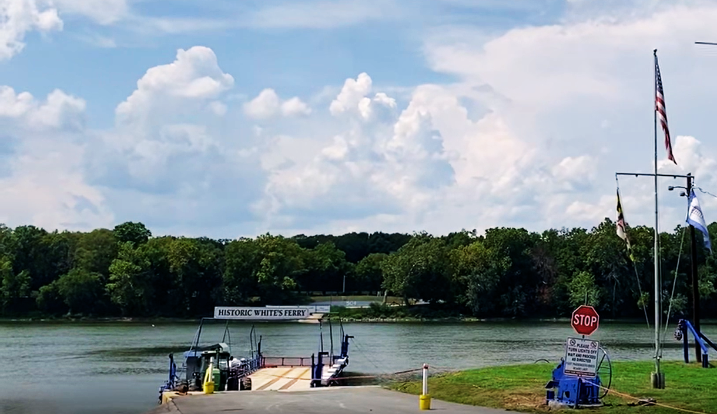

HISTORIC
WHITE’S FERRY

Slide 2
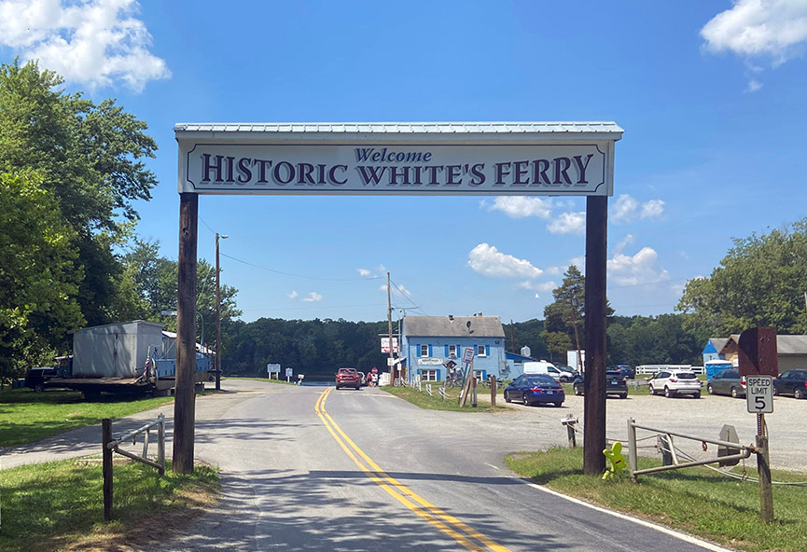
TABLE OF CONTENTS
01
Ferry Location & Need
02
Land Interests of Issue
03
Timeline
04
Solutions

Slide 3
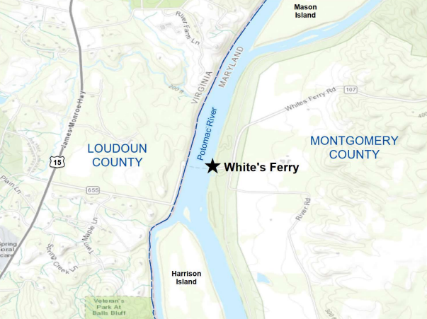
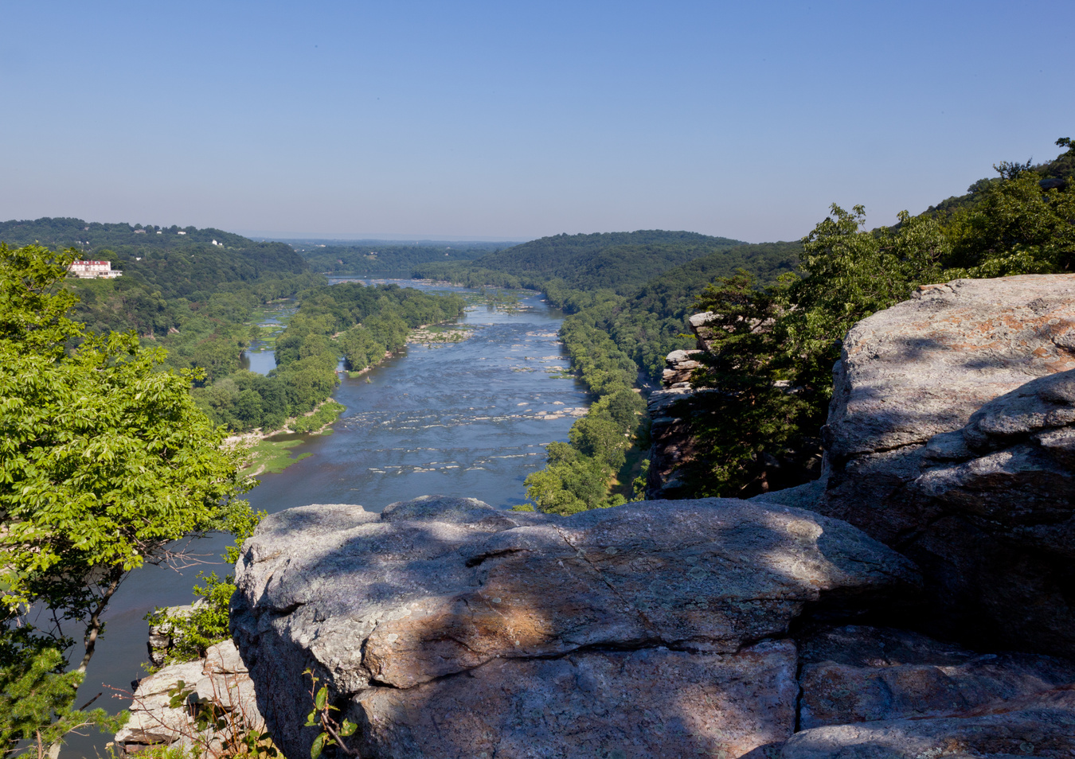
WHERE IS WHITE’S FERRY?

Slide 4
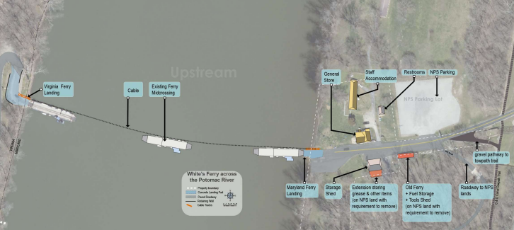
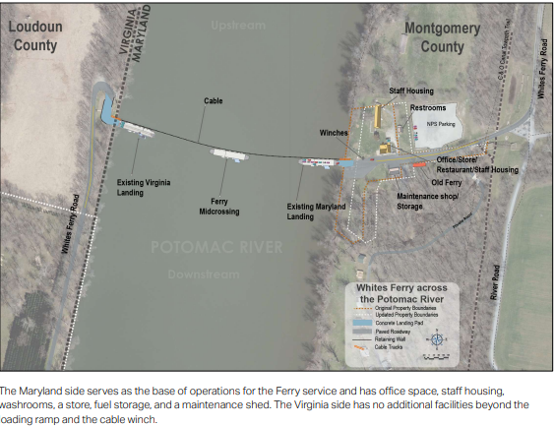
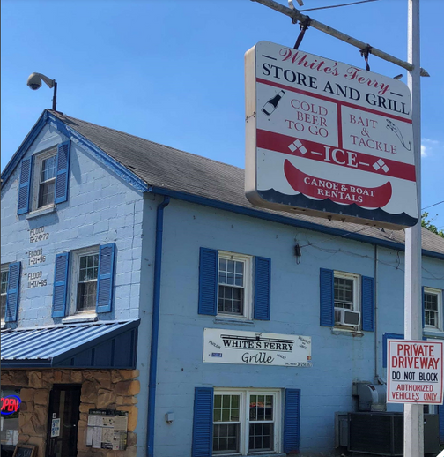
LOCATION
Upstream
The Maryland side serves as the base of operations for the Ferry service and has office space, staff housing and a store, fuel storage, cable tie down and a maintenance shed.
The Virginia side has no additional facilities beyond the loading ramp and the cable tie down.
POTOMAC RIVER
Downstream

Slide 5
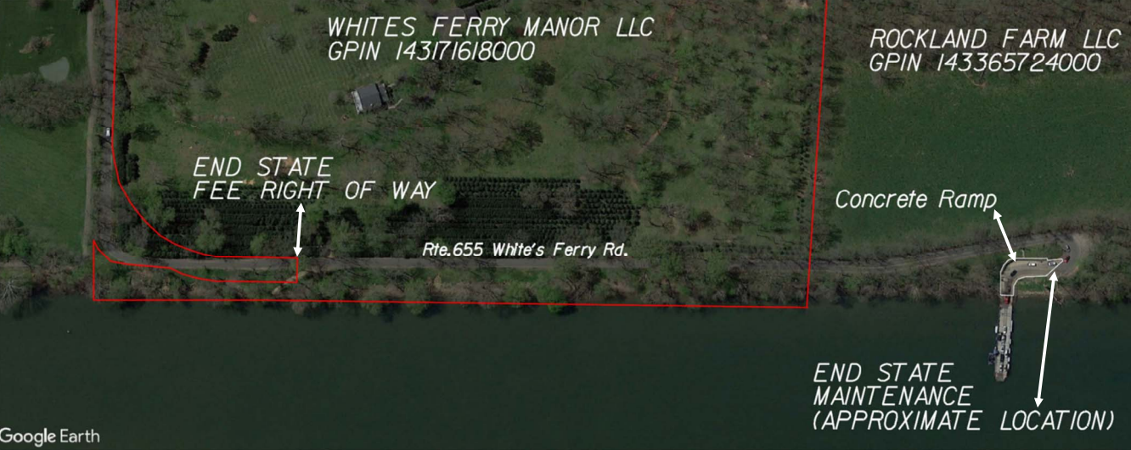
LOCATION
Map Provided by VDOT
Prescriptive Right-of-Way

Slide 6
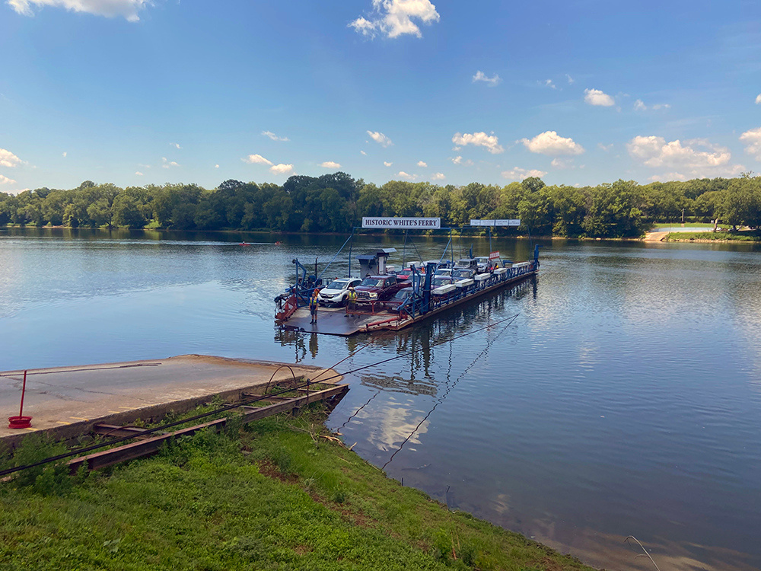
WHAT DOES THE FERRY DO?
Established in 1786, White’s Ferry serves as a significant transportation route between Maryland and Virginia, carrying over 1,000 people, 600-800 vehicles, per day (pre-pandemic).
Total economic impacts of ferry service are estimated at $9M- $25M annually. Impacting wineries, restaurants, bed and breakfast hotels, historic sites and more.
Travel time savings valued at $1M - $3.5M annually.
There is a great need for the ferry to reopen. It serves as an alternative to heavily traveled Route 15 to the North, and the American Legion Bridge to the South.
- Statistics from the joint Loudoun County and MCDOT White’s Ferry Operations Alternative Study, October 2021.

Slide 7
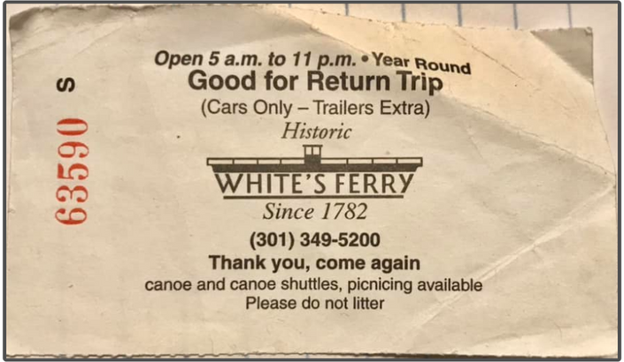
LAND INTERESTS
OF ISSUE
VA Landing Site
Virginia landing is owned by Rockland Farm, LLC.
Elizabeth (Libby) Devlin has been the main point of contact for negotiations. The land dispute resides here, with the Loudoun County ferry access point.
1871 condemnation of a ferry landing by Loudoun County.
Court was unable to conclude that the 1871 taking included the current landing.
Montgomery County precluded by law from controlling land in Virginia.
MD Landing Site & Ferry
Chuck and Stacy Kuhn, new ferry owners (as of 2021).
Herb Brown, previous ferry owner (until 2021).

Slide 8
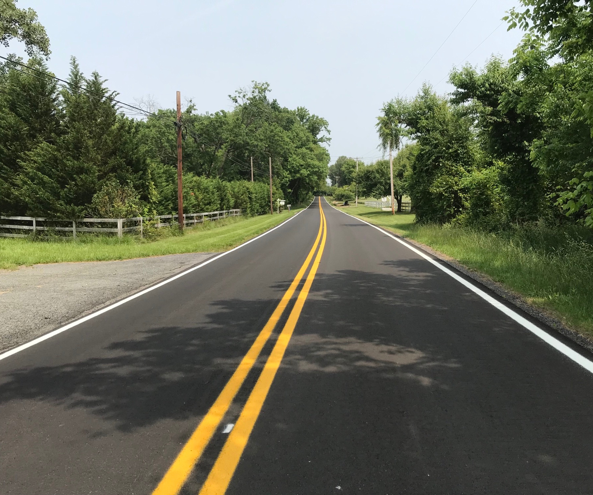
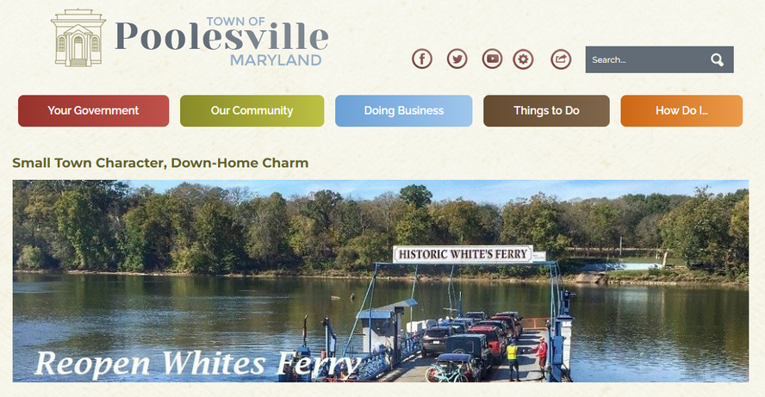
OTHERS INVOLVED
Montgomery County
Loudoun County
Town of Poolesville
Virginia DOT
Maryland DOT
Maryland Elected Officials

Slide 9







TIMELINE
1786 Whites Ferry opens as a commerce route between Virginia and Maryland. In 1871,Loudoun County exercised a taking of land and established public access.
1952 License agreement between White’s Ferry & Rockland Farm LLC was established.
2004 (Spring) Whites Ferry’s former owner makes improvements to the ferry landing in Virginia including a concrete retaining wall.
2009 Rockland LLC filed suit in VA Circuit Court against White’s Ferry alleging the operators of the ferry trespassed, damaged the property, and breached the license agreement.
2020 (November) VA Circuit Court rules in Rockland LLC’s favor, awards $102,175 in damages.
2020 (Late December) White’s Ferry cable breaks – operations ceased.
Notes:
2020 – NYE?

Slide 10







TIMELINE
2021 Ferry remained closed; cable repair not completed due to lack of agreement.
2021 (January) MCDOT confers with County Attorney on options for acquisition for the VA landing. It was determined that Montgomery County cannot acquire land in Virginia.
2021 (January) MCDOT meets with ferry owner, Herb Brown, to understand negotiations to date between the private parties.
2021 Joint effort with Loudoun County begins, establishing regular internal meetings between county governments. A ferry study is jointly commissioned. MCDOT establishes a webpage and an email list (2,500+) for public updates.
2021 (February) Chuck Kuhn purchases the ferry. Gives hope for a solution.
2021 (August) Rockland LLC asks for 50 cents per car indefinitely ($108,000+ a year at 600 cars daily).
Notes:
2020- first- Was it Rockland that denied the reopening or injunction?

Slide 11




TIMELINE
2021 (September) Town of Poolesville invites Chuck Kuhn to speak at a town hall meeting.
2021 (October) MCDOT and Loudoun County complete the White’s Ferry Operations Alternatives Study which establishes public need to support Loudoun’s authority to acquire the landing.
2021 (November) Loudoun County Board of Supervisors is briefed on options to restart the ferry. Montgomery County and State elected officials attend that meeting encouraging use of eminent domain.
2022 (January – July) Loudoun County attempts to negotiate easement acquisition with Rockland LLC.
2022 (November) At Regional Transportation Forum, MCDOT meets with VDOT Secretary Shepard Miller and MDOT Secretary Jim Ports to see if VDOT would be willing to acquire the landing. Secretaries discuss the topic at a second meeting. No agreement to reopen ferry achieved.
2023 (January) A joint offer brokered by MCDOT for $800,000 was made to Rockland LLC for the landing, which was considered and rejected.

Slide 12





TIMELINE
2023 (January - May) Montgomery County entertained acquiring the ferry based on advice that if it were publicly owned, Virginia would be willing to acquire the landing for public purpose.
2023 (February) Montgomery County explores 50 cents a car with Loudoun County and Kuhn, both of whom reject the idea of a per car payment.
The joint offer was raised to $1M. Rockland rejected the offer.
2023 (February) MCDOT contacts VDOT to explore Commonwealth’s willingness to obtain ferry landing.
2023 (May) VDOT determined they were unwilling to start a capital project to acquire the land, citing it as a local issue and confirmed the Commonwealth’s jurisdiction on White’s Ferry Road.
2023 (May) Montgomery County ceases acquisition discussions due to lack of solution for the Virginia landing.

Slide 13

TIMELINE
2023 (August) MCDOT encourages Rockland LLC to counter-offer following the general terms of the joint offer.
2023 (August) Montgomery County Executive meets with Chuck Kuhn to emphasize need for a solution. White’s Ferry agrees to provide new options to Rockland LLC.
2023 (September) Rockland LLC and White’s Ferry have facilitated discussion by neutral party known to both entities. Discussions break down.
MCDOT offers to arrange an independent mediator.
2023 (September) Montgomery County begins new meetings with other landowners and ferry advisors for alternative landing sites.
Conversations are ongoing.

Slide 14
SOLUTIONS
Overview of Solutions Sought and Being Sought
Notes:
Separate into individual slides
One time offers
Condemnation – Loudon, VDOT

Slide 15
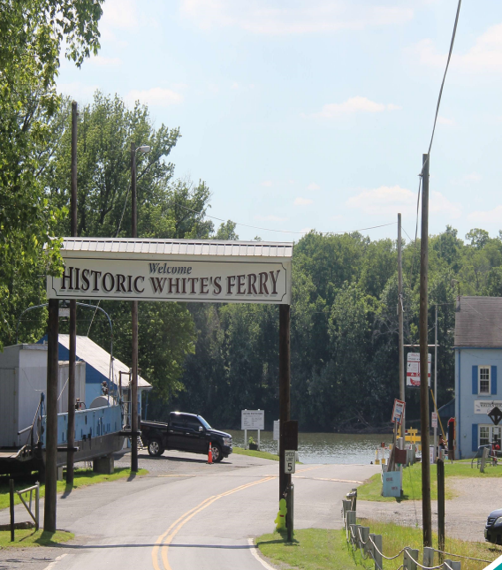
SOLUTION A
Private Party Negotiations
Multiple one-time offers made by White’s Ferry to Rockland LLC, as well as Rockland LLC to White’s Ferry, none of the offers were accepted.
Recently, the two private parties worked with a third party (mutual friend) to facilitate dialog about solutions; nothing came of this.
Notes:
Separate into individual slides
One time offers
Condemnation – Loudon, VDOT

Slide 16
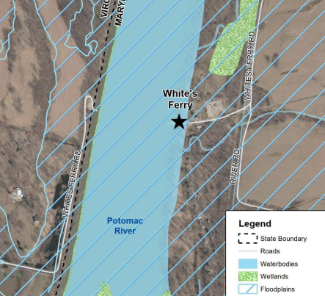
SOLUTION B
Acquisition by Loudoun County or VDOT
Land survey and plat prepared by Loudoun County.
Loudoun County has been unable to present an offer to Rockland LLC.
VDOT has declined to pursue acquisition as no public project in Virginia exists at this time.
Notes:
Separate into individual slides
One time offers
Condemnation – Loudon, VDOT

Slide 17
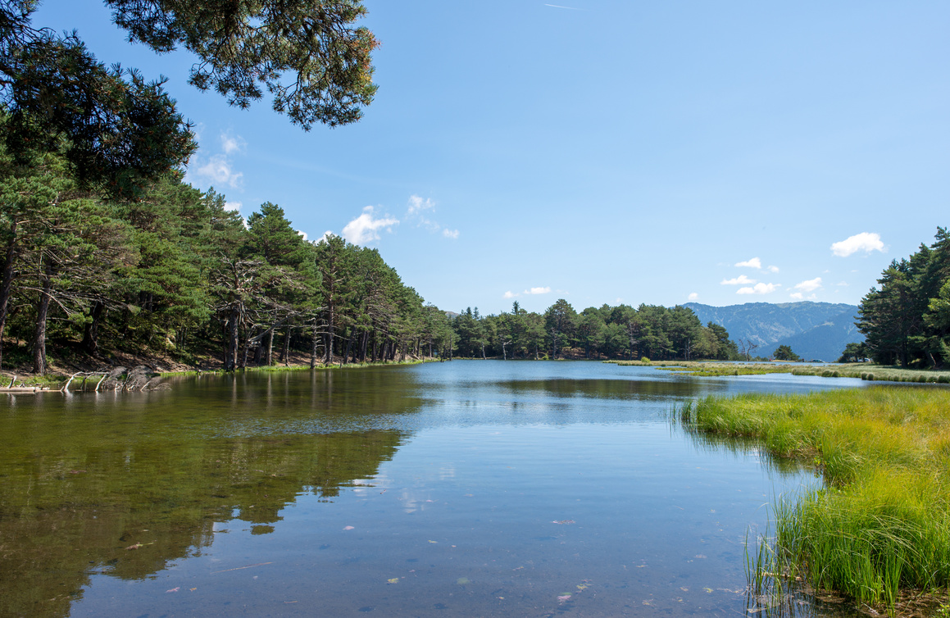
SOLUTION C
Joint Acquisition of Ferry Landing
Joint offer by White’s Ferry, Loudoun and Montgomery County.
Loudoun County would control the land rights.
Initial offer $800,000, rejected by Rockland LLC.
Revised offer of $1M, rejected by Rockland LLC.
Notes:
Separate into individual slides
One time offers
Condemnation – Loudon, VDOT

Slide 18
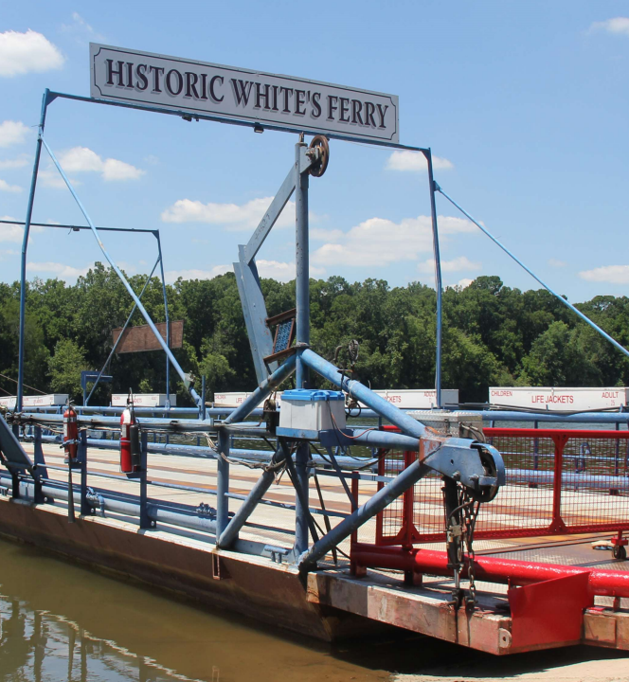
SOLUTION D
Third Party Acquisition
An entity not precluded from owning an interest in VA land could obtain rights to the landing from Rockland, LLC.
Another ferry operator could obtain rights from both parties to operate the ferry.
Notes:
Separate into individual slides
One time offers
Condemnation – Loudon, VDOT

Slide 19
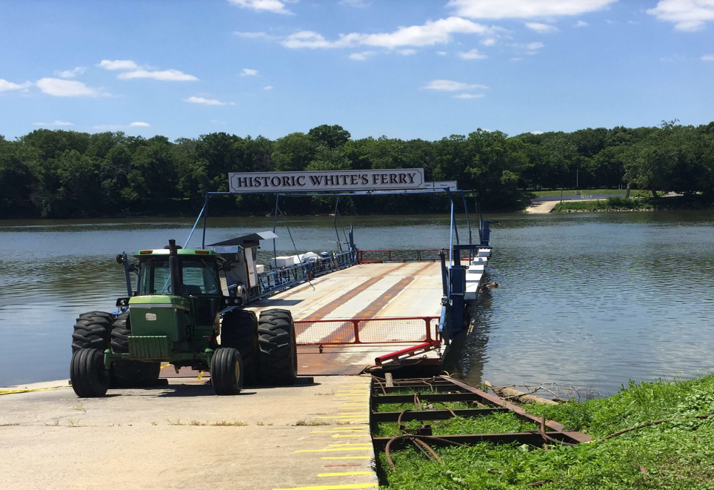
SOLUTION E
50 Cents per Car Paid to Rockland LLC
Current and previous ferry owners unwilling to pay a per vehicle fee.
Montgomery County attempted to broker agreement without success.
Notes:
Separate into individual slides
One time offers
Condemnation – Loudon, VDOT

Slide 20
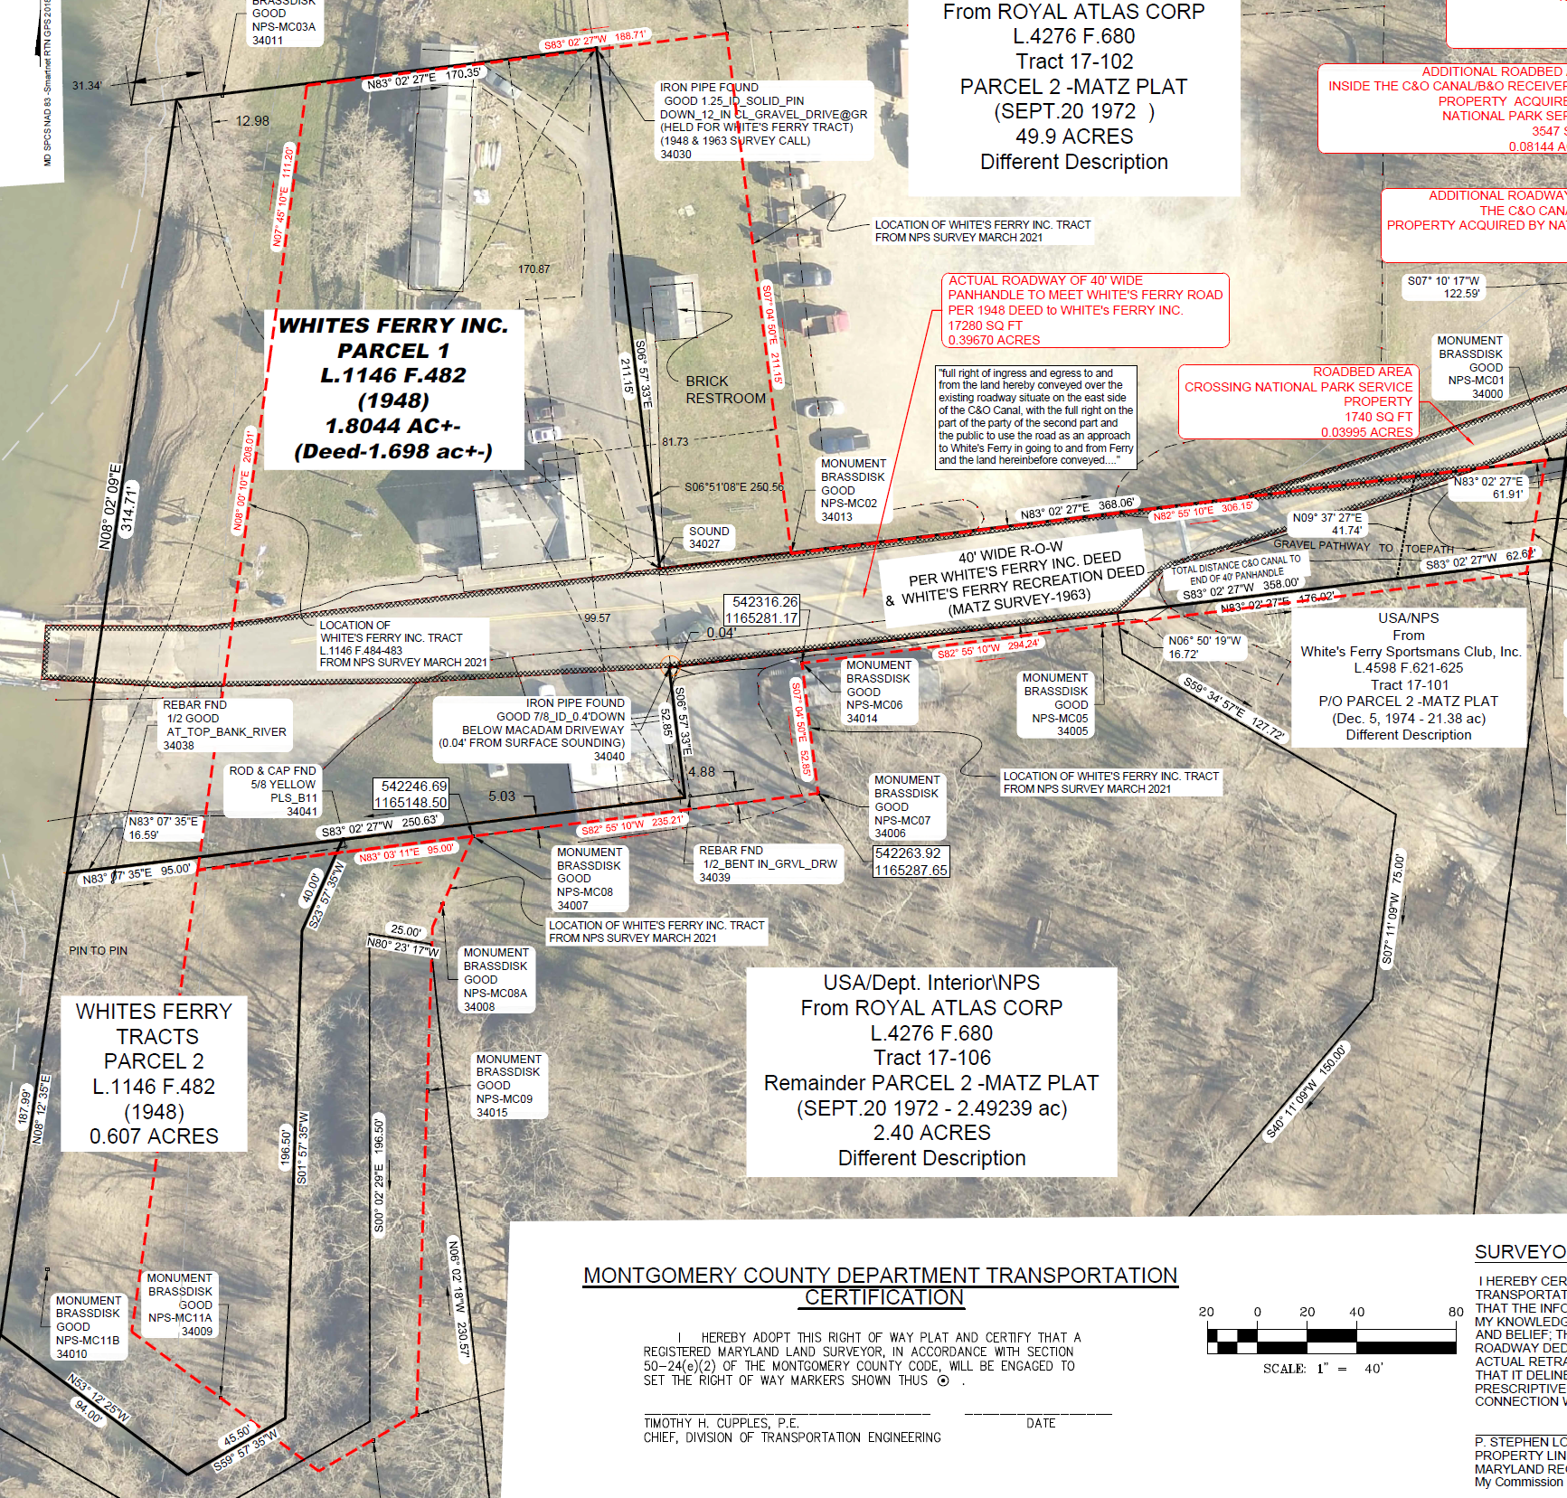
SOLUTION F
Public Acquisition of White’s Ferry
Explored by Montgomery County to facilitate public action in Virginia.
Does not resolve Virginia landing problem by itself.
Notes:
Separate into individual slides
One time offers
Condemnation – Loudon, VDOT

Slide 21
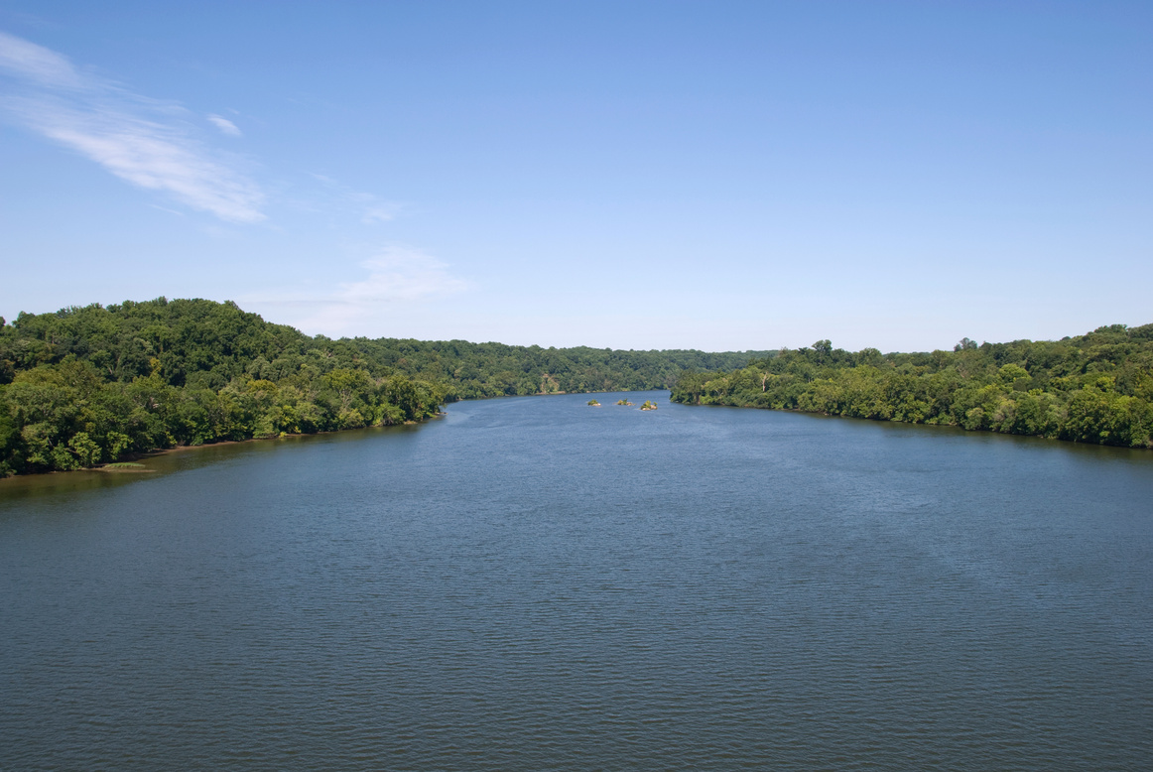
SOLUTION G
Explore New Ferry Locations
Options:
Use of current MD landing with new VA landing
New MD and VA landings
Conversations with multiple landowners are ongoing.
Likely to require land acquisition, design, permitting, construction and potential vessel acquisition
Notes:
Separate into individual slides
One time offers
Condemnation – Loudon, VDOT

Slide 22
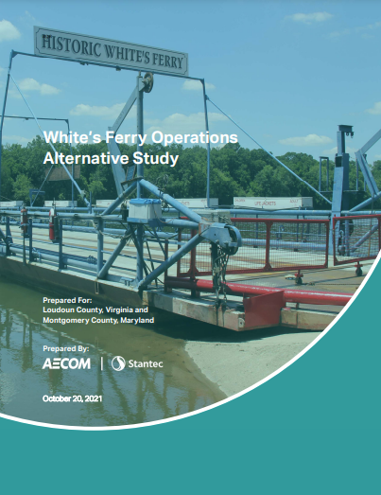

Questions?
Chris Conklin, Director
https://www.montgomerycountymd.gov/DOT/Projects/whitesferry/index.html

